Slide 1

State Corporation Commission
Bureau of Insurance
Updated slide deck subsequent to the 2024 ACA Rates Presentation to account for a budgeted 2024 Commonwealth Health Reinsurance Program
October 11, 2023

Slide 2
Presentation Overview
Welcome and Introduction
  Alexander Skirpan, Chief Hearing Examiner,
  State Corporation Commission (SCC)
Broad Overview of Virginia’s Individual and Small Group Health Insurance Markets and Key Issues
  Julie Blauvelt, Life & Health Division Deputy Commissioner, SCC Bureau of Insurance
Discussion of Key Observations – Virginia’s Individual and Small group Health Insurance Rates
  David Shea, Health Actuary, SCC Bureau of Insurance
Presentation of Carriers’ Rates
  Carrier Presenters
Closing
  Alexander Skirpan

Slide 3
Number of Carriers in Virginia in the Individual Market - On and Off Exchange
*2024 QHP applications received through SERFF

Slide 4
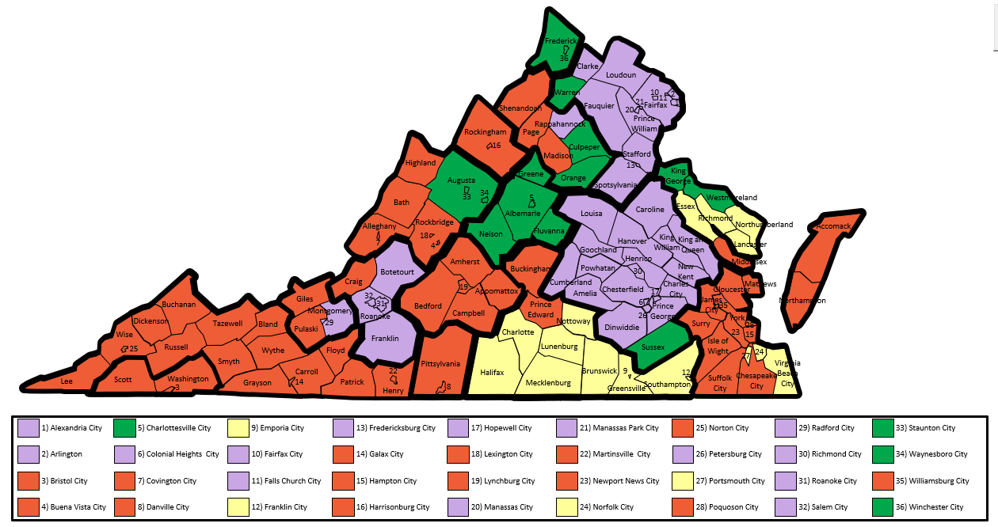
2024 Individual Market On Exchange - Carrier Service Area Applications
As of 8/1/2023

Slide 5
Virginia Individual Market Share by 2024 Projected Covered Lives ¹
¹ Covered lives based on carrier projected member months submitted in the carrier Virginia Rate Filing Templates

Slide 6
Virginia Individual ACA Total Enrollment and weighted Average Premium PMPM 2019 – 2024
Source: 2022 and prior - Experience period data submitted in carrier ACA filings.
2019 and 2020 exclude data from Virginia Premier with approx. 5000 members. 2022 data excludes Bright Health.
2023 and 2024 - projected PMPM premium and enrollment from carrier ACA filings, actual 3/1/2023 enrollment for 2023.

Slide 7
Reinsurance Program waiver application
The General Assembly directed the SCC to apply for a waiver that provides federal funding to Virginia to largely support a reinsurance program for the individual ACA market. CMS approved the program for up to 5 years beginning in 2023.
The program reduces health carriers’ costs, reducing premiums. Persons who purchase individual coverage but do not receive federal subsidies (APTCs) benefit the most from the program.
The law sets the goal of the program to decrease premiums by up to 20% depending on available revenue.
The SCC relies on the General Assembly money committees to target the level of funding Virginia will contribute to the program. For 2023, legislators selected a 15% premium reduction target with an estimated cost to Virginia of about $69 million.

Slide 8
2023 Reinsurance program
The 2023 program targeted a 15.6% weighted average premium PMPM reduction.
Federal agencies granted approval of the program that pays a portion of expensive claims using a combination of state and federal funds.
  Estimated federal funds: $331,877,124
  Estimated Virginia funds: $43,424,482
Reinsurance program parameters set by SCC reduced the 2023 weighted average premium PMPM 17.3% from what it would have been with no reinsurance. From 2022 to 2023, the weighted average premium PMPM decreased 13%.

Slide 9
2024 REINSURANCE PROGRAM
An actuarial study* found that many people continued to purchase individual coverage in Virginia without federal advance premium tax credits. This raises the projected state costs for the program.
The Budget Bill enacted during the 2023 Special Session I directs the Bureau of Insurance to continue the Commonwealth Health Reinsurance Program in plan year 2024 with a target for premium reduction of 15%.
  Our actuarial study* estimates that such a program will cost the state approximately $66.4 million.
  Virginia could expect to receive more than $350 million in Federal funds for a program of that size.
For more information, go to: https://scc.virginia.gov/pages/Reinsurance-Program
* Oliver Wyman 2024 Reinsurance Modeling Results, April 14, 2013 – funded by a grant from U.S. Health and Human Services

Slide 10
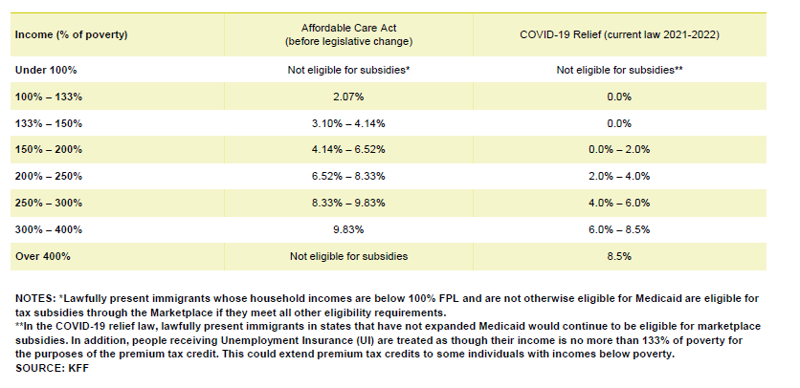
ARPA ACA Subsidies

Slide 11
2023 Marketplace Open Enrollment Period
Number of Consumers with a Marketplace Plan Section | Consumers with APTC | Average Premium | Average Premium after APTC among Consumers Receiving APTC
346,140 | 304,469 | $485 | $86
The 2023 Open Enrollment Period for the Health Insurance Marketplaces ran between November 1, 2022 and January 15, 2023 for the 33 states that used HealthCare.gov.
Source: 2023 OEP State-level Public Use File at www.cms.gov

Slide 12
Virginia Small Group ACA Total Enrollment and weighted Average Premium PMPM 2019 – 2024
Source: 2022 and prior - premium and enrollment from experience period data submitted in carrier ACA filings.
2023 and 2024 - projected PMPM premium and enrollment from carrier ACA filings, actual 3/1/2023 enrollment for 2023.

Slide 13
Key Takeaways
The individual market continues to show signs of a healthy market
  Increased carrier participation/competition
  At least two carriers in all areas of Virginia
  ARPA subsidies – increasing enrollment
  Medicaid unwinding adding enrollment to the commercial market
The Reinsurance Program was effective in 2023 at reducing weighted average premium PMPM 17.3% from what it would have been without reinsurance.
Company rate filings project the Reinsurance Program for 2024 will reduce weighted average premium PMPM 16.4% from what it would have been without reinsurance, and 2.4% from 2023 rates.
Small group market facing some challenges
  More study of this market

Slide 14
2024 Rate Impact of Reinsurance
2024 average market-wide rate adjustments for reinsurance ranged from 8.5% to -3.7%.
The 2024 weighted average premium PMPM prior to reinsurance was projected to increase 16.6% from 2023; after reinsurance, the 2024 weighted average premium PMPM is projected to decrease 2.4% from 2023.
The 2024 weighted average premium PMPM prior to reinsurance is $577.63; the 2024 weighted average premium PMPM after reinsurance is $483.15.

Slide 15
2024 Premium Drivers
Top Premium Drivers*
INDIVIDUAL (3.9%)
Reinsurance: 1.2%
Risk Adjustment: 7.5%
Experience: -7.0%
SMALL GROUP (5.1%)
Experience: -4.7%
Increase in Benefits: 1.4%
*Percentages based on a straight average.

Slide 16
Virginia 2024 ACA Pricing Trends
Individual
 | INPATIENT |  |  |  | OUTPATIENT |  |  |  | PHYSICIAN |  |  |  | Rx
Carrier | Cost | Util | Total |  | Cost | Util | Total |  | Cost | Util | Total |  | Cost | Util | Total |  | TOTAL
Cigna | 7.4% | 2.5% | 10.1% |  | 7.8% | 2.5% | 10.5% |  | 1.8% | 2.5% | 4.3% |  | 6.9% | 1.2% | 8.2% |  | 8.3%
Optimum Choice | 1.9% | 3.8% | 5.8% |  | 2.2% | 5.7% | 8.0% |  | 0.6% | 3.2% | 3.8% |  | 4.8% | 3.8% | 8.8% |  | 5.7%
Sentara Health Plans | 3.6% | 1.0% | 4.6% |  | 3.6% | 1.0% | 4.6% |  | 3.6% | 1.0% | 4.6% |  | 10.4% | 0.1% | 10.5% |  | 6.2%
Small Group
 | INPATIENT |  |  |  | OUTPATIENT |  |  |  | PHYSICIAN |  |  |  | Rx
Carrier | Cost | Util | Total |  | Cost | Util | Total |  | Cost | Util | Total |  | Cost | Util | Total |  | TOTAL
Optimum Choice | 3.3% | 4.4% | 7.8% |  | 3.3% | 4.4% | 7.8% |  | 3.3% | 4.4% | 7.8% |  | 3.3% | 4.4% | 7.8% |  | 7.8%
Sentara Health Plans | 3.0% | 1.0% | 4.0% |  | 4.8% | 1.0% | 5.8% |  | 3.0% | 1.0% | 4.0% |  | 10.4% | 0.1% | 10.5% |  | 6.0%

Slide 17
ACA Loss Ratio Experience
Source: Historical and projected carrier experience data submitted in the annual carrier ACA rate filings
Note: 2020 and 2021 data excludes Virginia Premier, 2022 excludes Bright Health

Slide 18
Virginia Individual Average* Rate Change
Source: Average change in approved Calibrated Plan Adjusted Index Rates, annual carrier ACA rate filings
*Percentages based on a straight average for 2019-2022 and a weighted average premium PMPM for 2023-2024.

Slide 19
Key Takeaways
2024 rate changes for individual reflect the continuation of the reinsurance program, while small group rate changes are similar to past years
Pricing trends saw a slight increase, driven by cost of hospital services and prescription drugs
Collectively, carriers estimate a 10% increase in individual enrollment in 2024 and a slight increase in small group

Slide 20
Presenting Companies
Cigna Health and Life Insurance Company - Individual
Optimum Choice, Inc. – Individual and Small Group
Sentara Health Plans – Individual and Small Group
Note: Company presentation data is from Tab VIII of the Virginia ACA Rate Filing Templates submitted as of 8/1/23

Slide 21
Issues to be Addressed
Issues for the Presenting Companies to Address
Enrollment, morbidity and premium impact of eliminating the tobacco surcharge
Enrollment and morbidity impact of Medicaid unwinding
Change in trends post-COVID and how they compare to pre-COVID and during COVID
(Sentara Health Plans only) Reasons behind Sentara’s name change

Slide 22
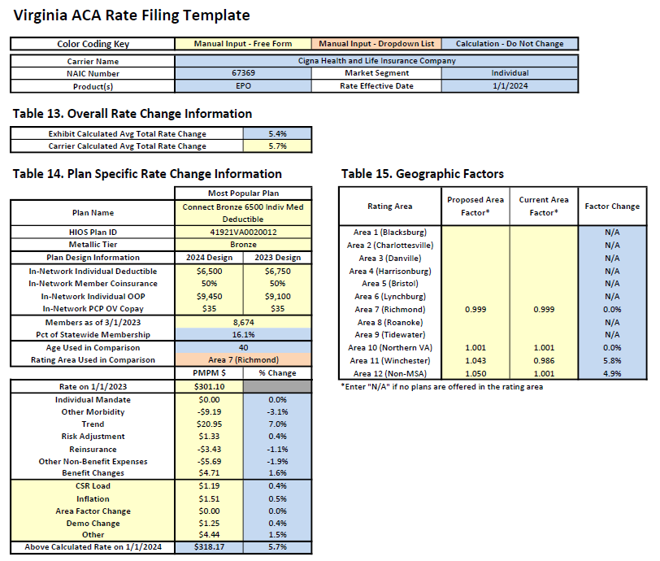
Cigna Health and Life Insurance Company
Individual
Presenter:
Cathy Wang,
Actuarial Advisor

Slide 23
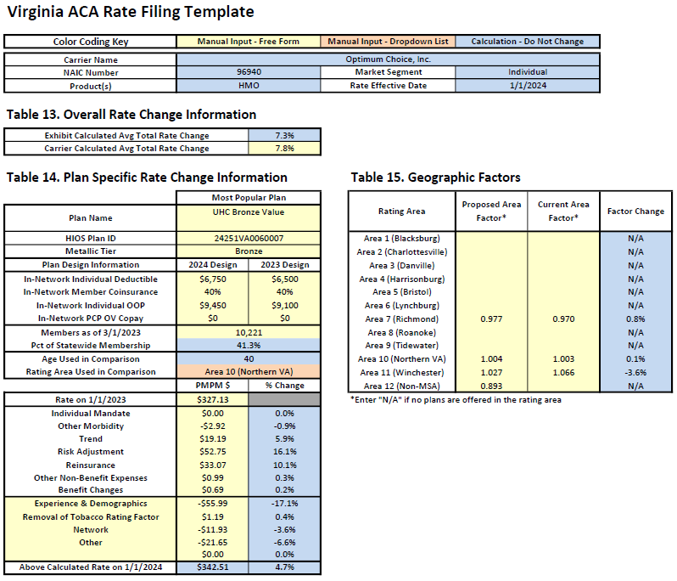
Optimum
Choice, Inc.
Individual
Presenter:
Katherine Simon
Director of Actuarial Services

Slide 24
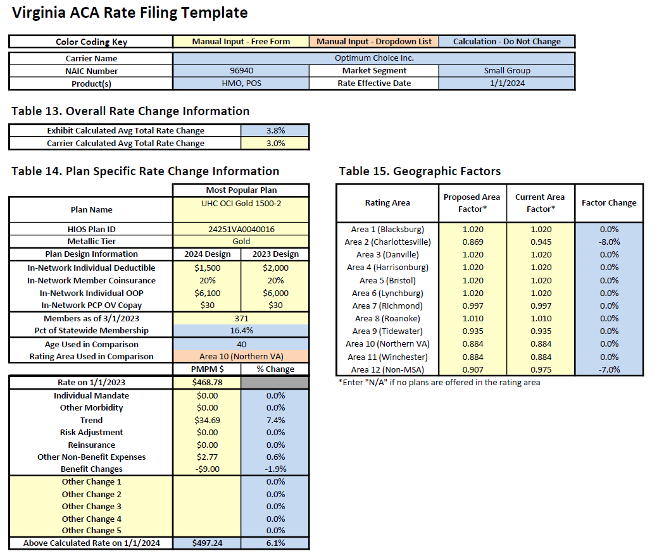
Optimum
Choice, Inc.
Small Group
Presenter:
Katherine Simon
Director of Actuarial Services

Slide 25
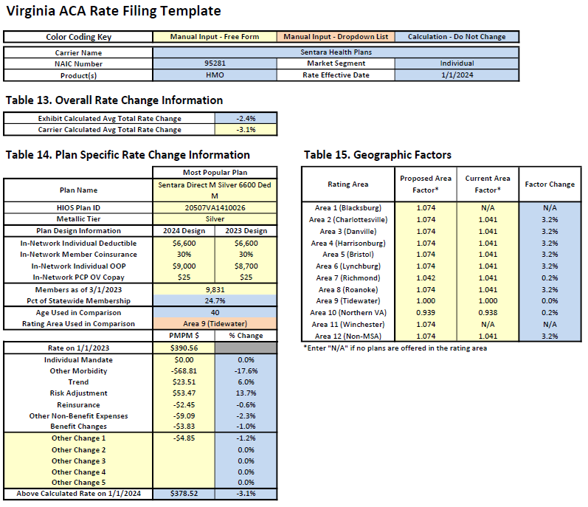
Sentara Health Plans
Individual
Presenter:
Margaret Chance,
Principal and Consulting Actuary

Slide 26
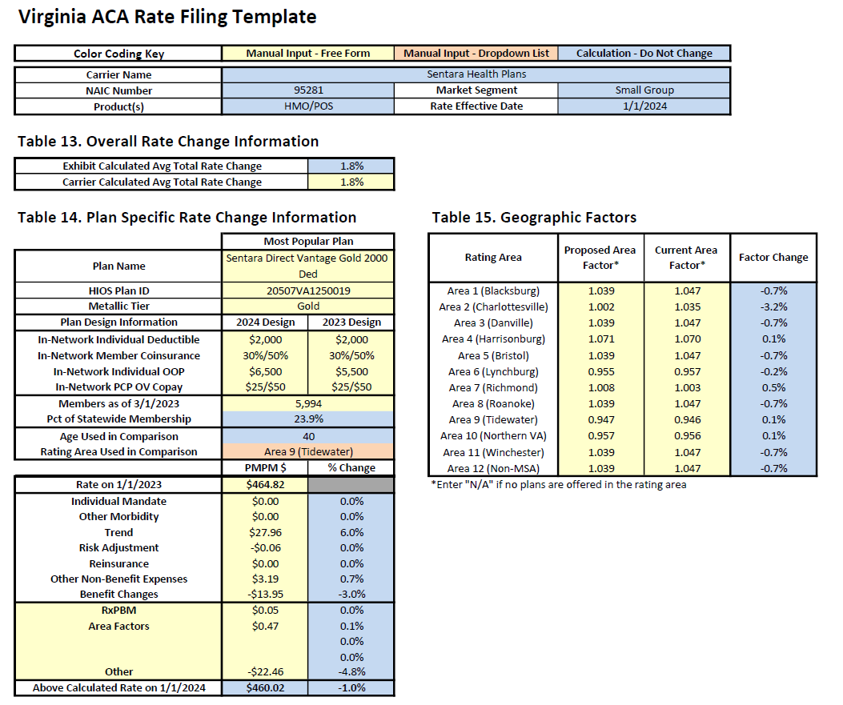
Sentara Health Plans
Small Group
Presenter:
Margaret Chance,
Principal and Consulting Actuary

Slide 27
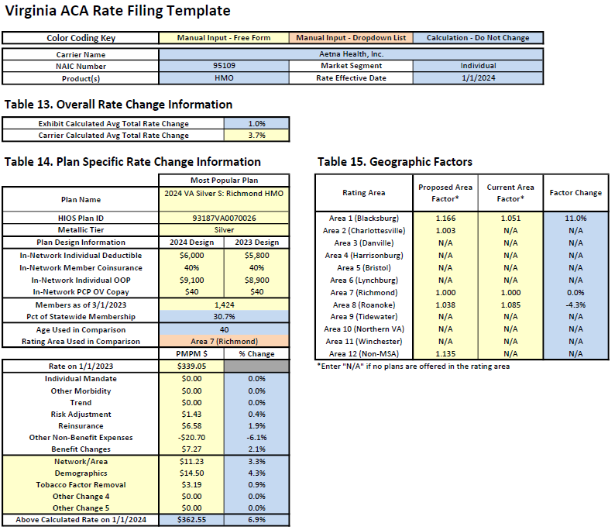
Aetna Health, Inc.
Individual

Slide 28
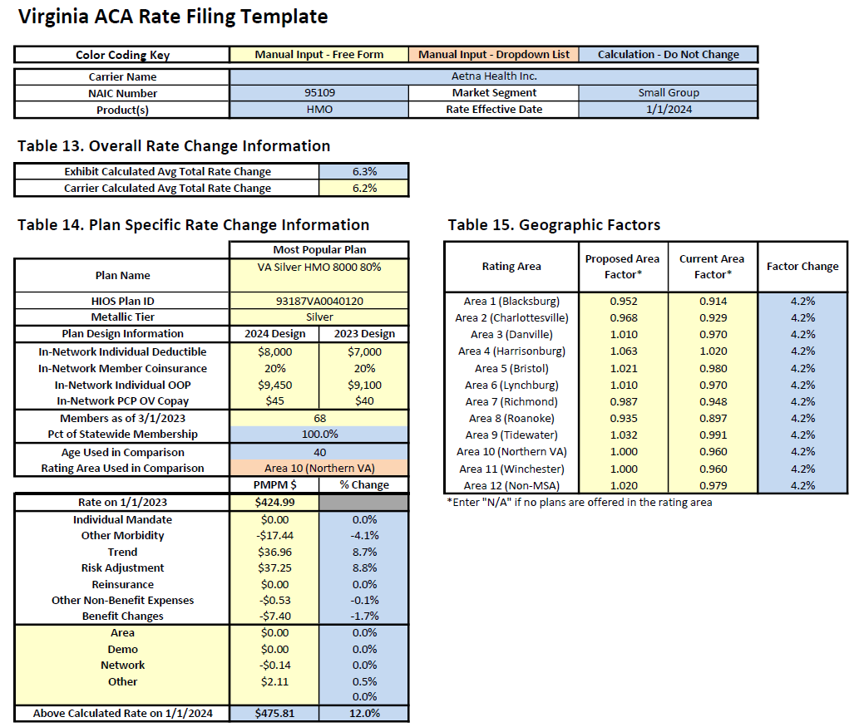
Aetna Health, Inc.
Small Group

Slide 29
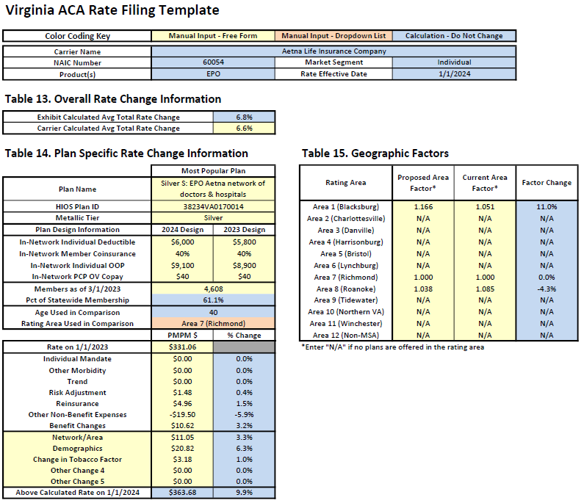
Aetna LIFE INSURANCE Company
Individual

Slide 30
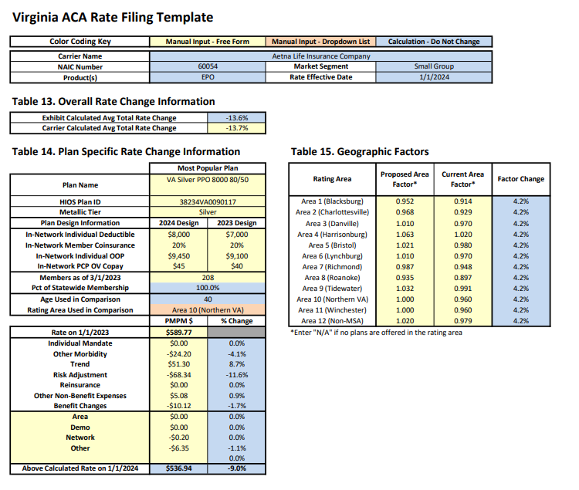
Aetna LIFE INSURANCE Company
Small group

Slide 31
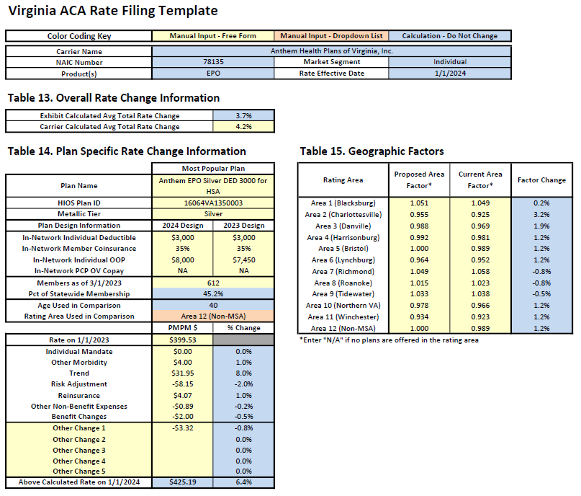
Anthem health plans of Virginia, inc. individual

Slide 32
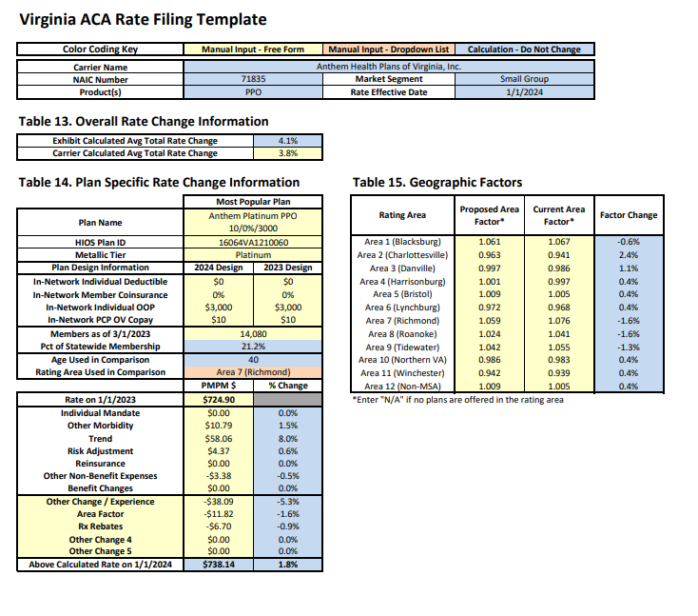
Anthem health plans of Virginia, inc.
Small group

Slide 33
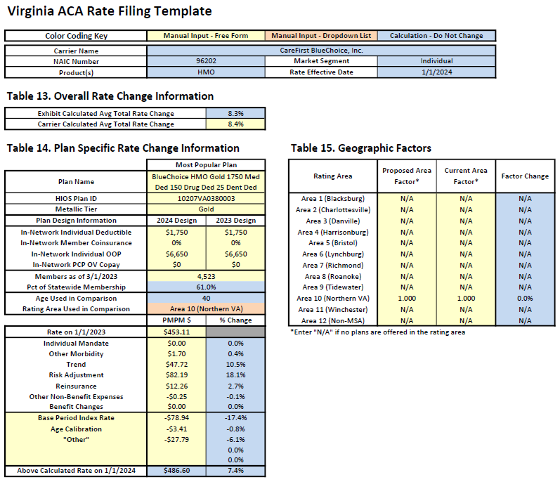
Carefirst bluechoice, inc. individual

Slide 34
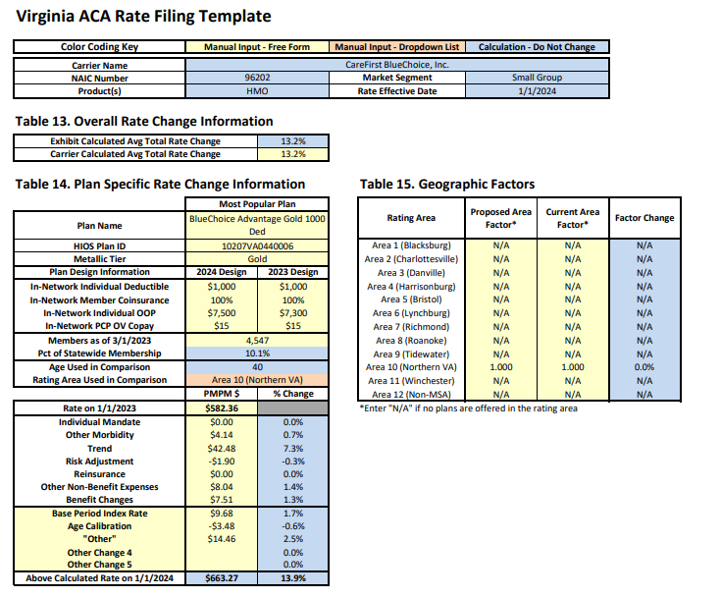
Carefirst bluechoice, inc. small group

Slide 35
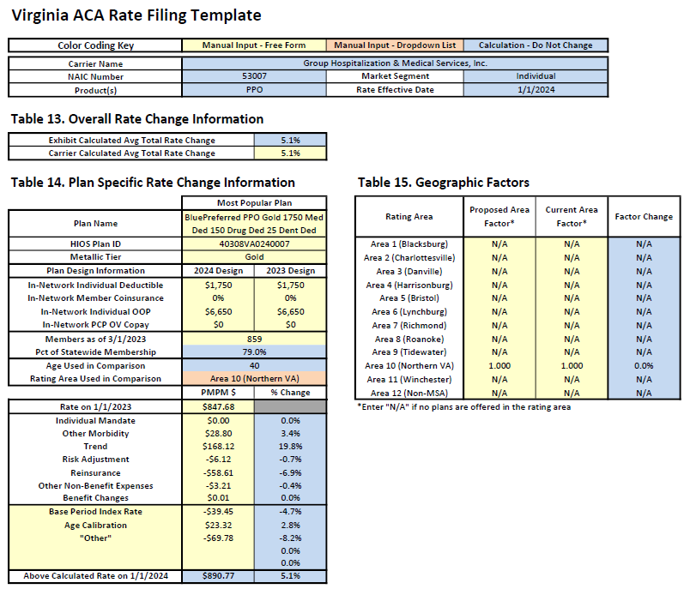
Group hospitalization & medical services, inc. individual

Slide 36
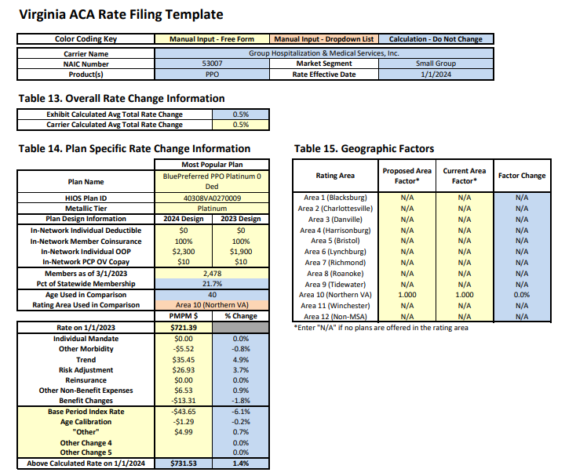
Group hospitalization & medical services, inc. small group

Slide 37

Healthkeepers, inc. individual

Slide 38
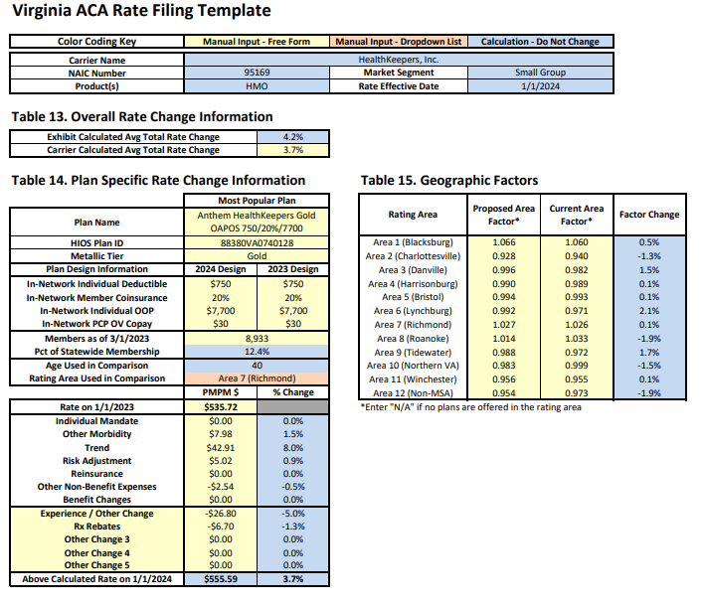
Healthkeepers, inc. small group

Slide 39
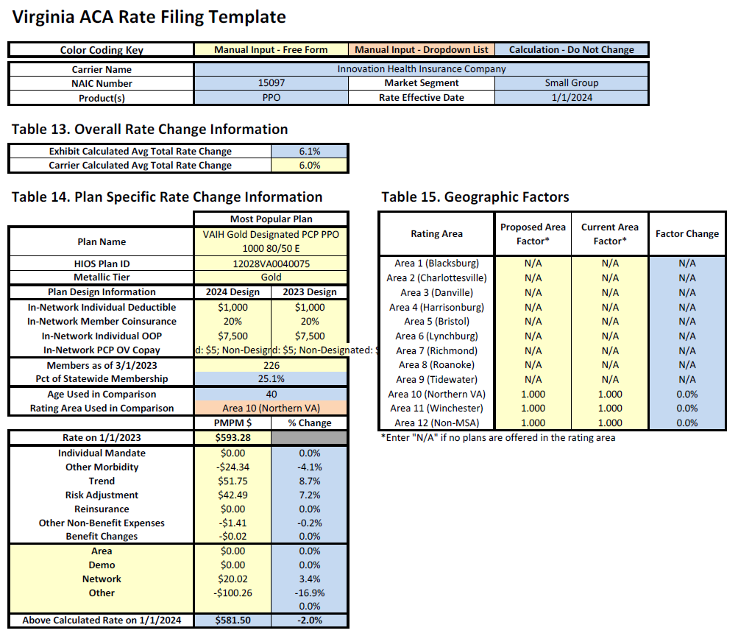
Innovation health insurance company small group

Slide 40

Innovation health plan, inc. individual

Slide 41
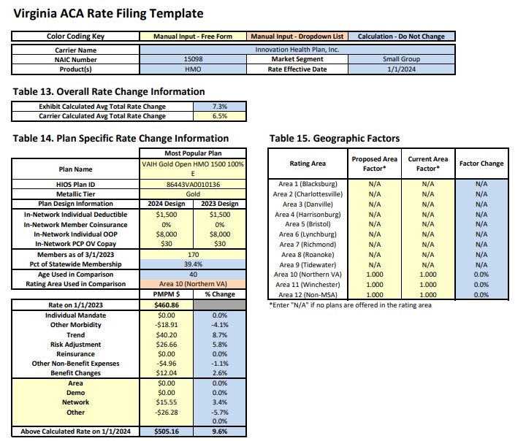
Innovation health plan, inc. small group

Slide 42
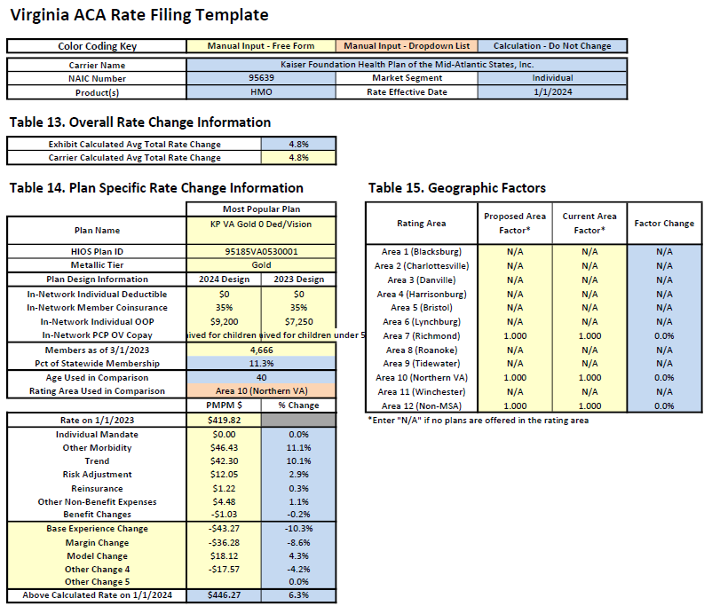
Kaiser foundation health plan of the mid-Atlantic states, inc. individual

Slide 43
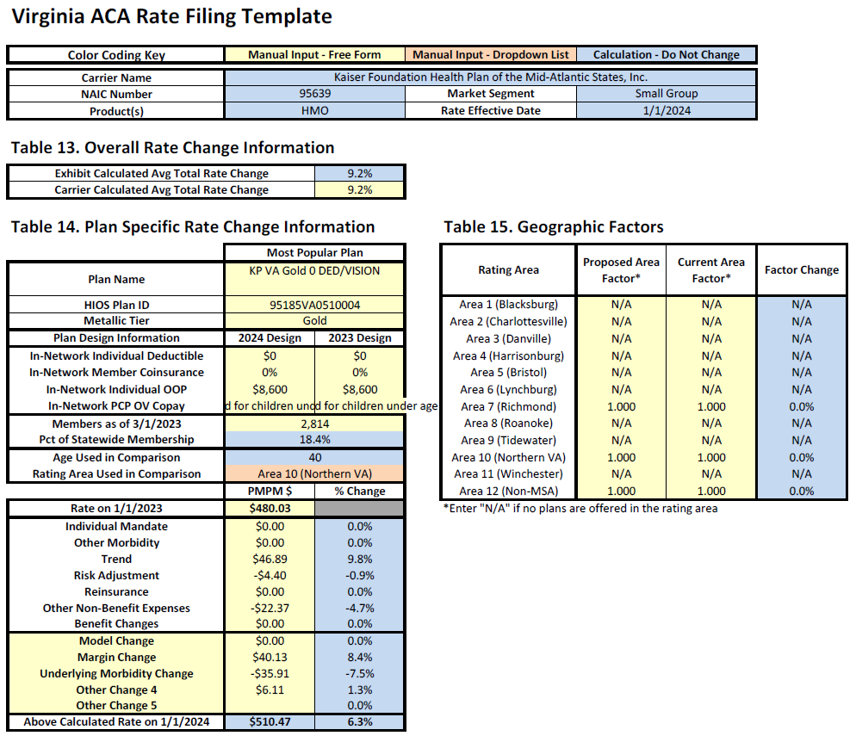
Kaiser foundation health plan of the mid-Atlantic states, inc. small group

Slide 44

Oscar insurance company individual

Slide 45
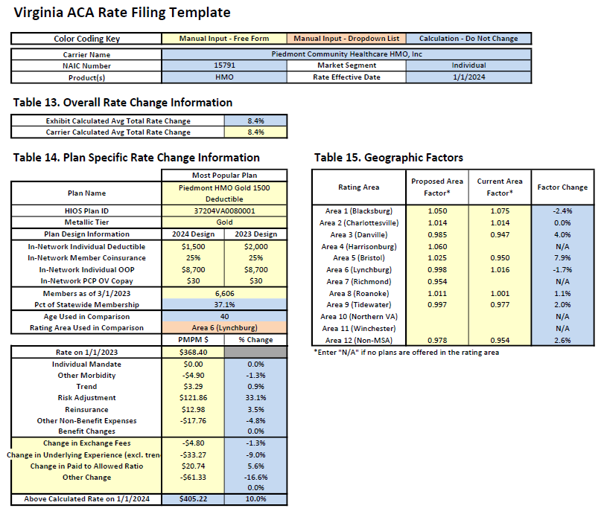
Piedmont community healthcare hmo, inc. individual

Slide 46
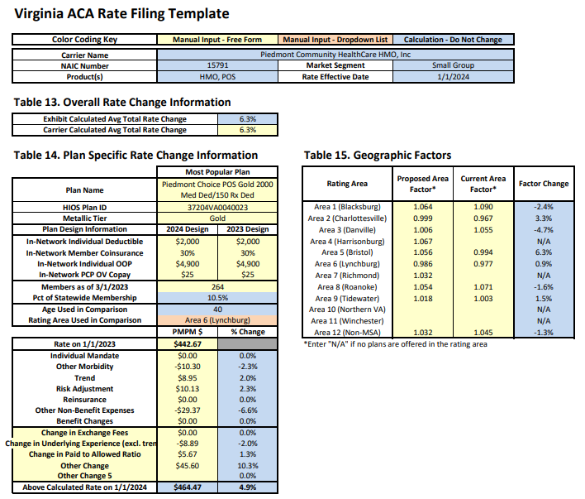
Piedmont community healthcare hmo, inc. small group

Slide 47
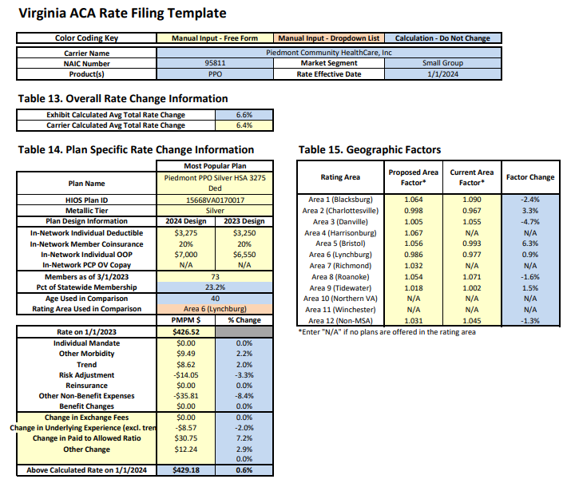
Piedmont community healthcare, inc. small group

Slide 48

sentara health insurance company individual

Slide 49
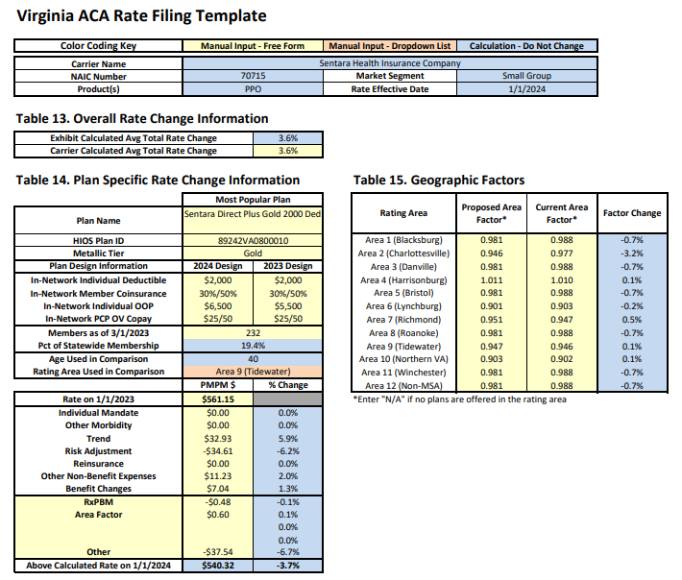
sentara health insurance company small group

Slide 50

Unitedhealthcare insurance company small group

Slide 51

Unitedhealthcare of the mid-Atlantic, inc. small group

Slide 52
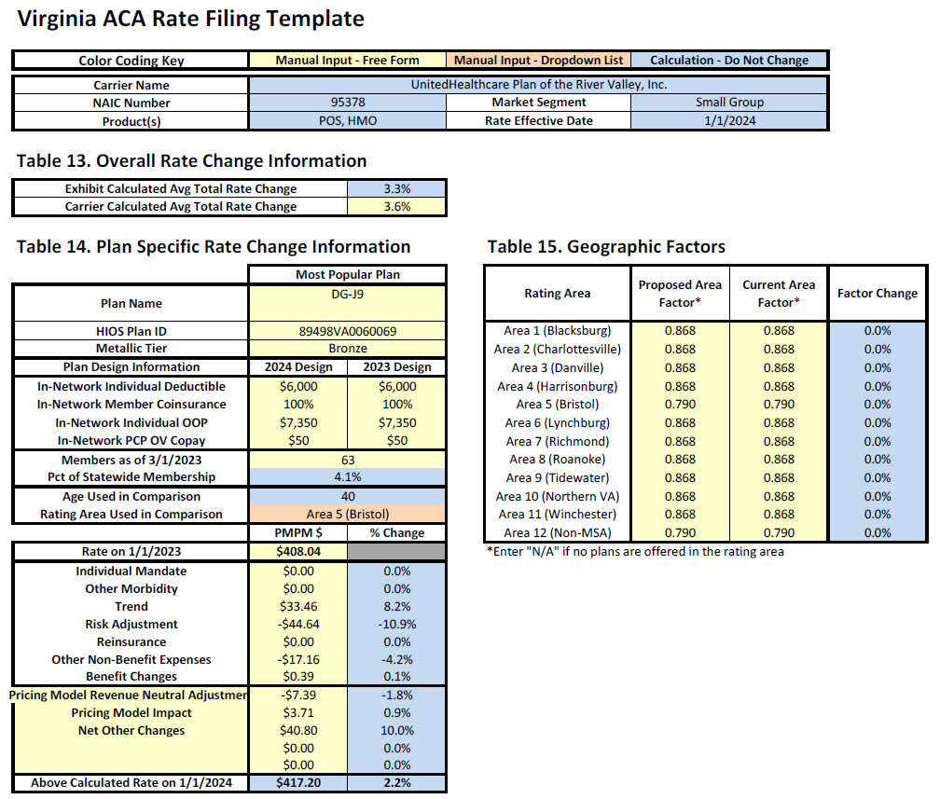
Unitedhealthcare plan of the river valley, inc. small group

