Slide 1

State Corporation Commission
Bureau of Insurance
2023 ACA Rate Presentations
August 10, 2022

Slide 2
Presentation Overview
Welcome and Introduction
  Alexander Skirpan, Chief Hearing Examiner, State Corporation Commission (SCC)
Broad Overview of Virginia’s Individual and Small Group Health Insurance Markets and Key Issues
  Julie Blauvelt, Life & Health Division Deputy Commissioner, SCC Bureau of Insurance
Discussion of Key Observations – Virginia’s Individual and Small Group Health Insurance Rates
  David Shea, Health Actuary, SCC Bureau of Insurance
Presentation of Carriers’ Rates
  Carrier Presenters
Closing
  Alexander Skirpan

Slide 3
Abbreviated State Corporation Commission (SCC) Organizational Chart
SCC Commissioners
Legal Support
Chief Administrative Officer
Administration
Public
Utilities
Financial Services
Bureau of Insurance
Health Benefit Exchange
Clerk’s Office

Slide 4
Reinsurance Program
Reinsurance pays a portion of expensive claims and reduces health carriers’ costs, reducing premiums.
Virginia will use federal and state funds to operate a reinsurance program for up to 5 years beginning in 2023.
For 2023 claims, the Program:
  Pays 70% coinsurance on claims between $40,000 and $155,000
  Reduced premiums by 19.2%, compared to an expected 15.6%
For more information, go to: https://scc.virginia.gov/pages/Reinsurance-Waiver

Slide 5
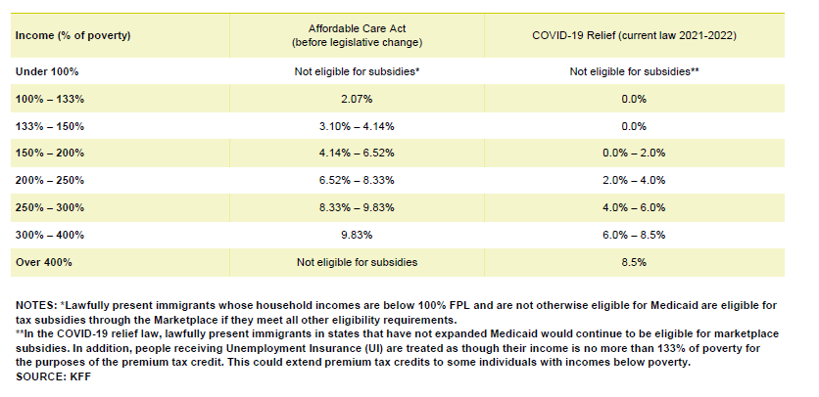
American Rescue Plan Act (ARPA) and ACA Subsidies

Slide 6
Number of Carriers in Virginia in the Individual Market On and Off Exchange
*2023 QHP applications received through SERFF

Slide 7
Virginia Individual Market Share – by 2023 Projected Covered Lives*
*Covered lives based on carrier projected member months submitted in the carrier Virginia Rate Filing Templates

Slide 8
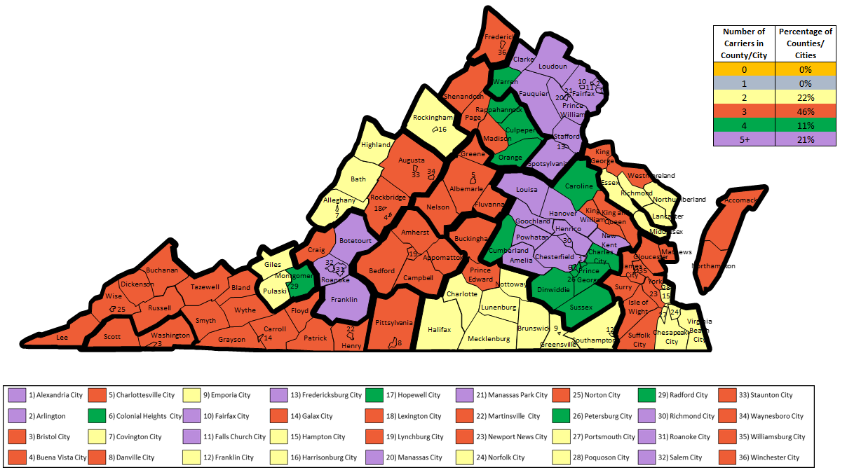
2023 Individual On-Exchange Market Carrier Service Area Applications As of 08/01/2022

Slide 9
Virginia Individual ACA Total Enrollment and
Average Premium PMPM 2018 – 2023
Source: 2021 and prior - premium and enrollment from experience period data submitted in carrier ACA filings. 2019 and 2020 exclude data from Virginia Premier with approximately 5000 members.
2022 and 2023 - projected PMPM premium and enrollment from carrier ACA filings, actual 3/1/2022 enrollment for 2022. 2022 data excludes Bright Health.

Slide 10
Virginia Small Group ACA Total Enrollment and
Average Premium PMPM 2018 – 2023
Source: 2021 and prior - premium and enrollment from experience period data submitted in carrier ACA filings.
2022 and 2023 - projected PMPM premium and enrollment from carrier ACA filings, actual 3/1/2022 enrollment for 2022.

Slide 11
Premium Subsidies through the Virginia Health Benefit Exchange
Source: CMS 2022 Marketplace Open Enrollment Public Use Files, November 1, 2021 – January 15, 2022

Slide 12
ARPA and Reinsurance Effect on Individual Market Enrollment
Source: Adapted from Virginia 2023 Reinsurance Modeling Results – Draft, Oliver Wyman August 24, 2021

Slide 13
Key Takeaways
Individual market continues to show signs of a healthy market
  Increased carrier participation/competition
  At least two carriers in all areas of Virginia
  Lowest average rate PMPM since 2017 (Reinsurance)
  ARPA subsidies – increasing enrollment
  PHE/Medicaid unwinding – not a factor yet
Small group market may be facing some challenges
Reinsurance Program new for 2023
  Reduces unsubsidized premium
  Increases unsubsidized enrollment

Slide 14
Summary of Federal Changes (2023 NBPP)
Standardized Plans
Carriers are required to offer standardized plans at every product network type, metal level and service area where non-standardized plans are offered
There are two sets of standardized plans at each metal level, bronze equivalent and silver CSR variation
Plans are tailored to unique cost-sharing laws in different sets of states
Changes to Actuarial Value de minimis Ranges
Ranges for all individual and small group metal levels return to the original +2/-2 range
+2/0 for individual silver QHPs and +1/0 for silver CSR variations
Influences generosity of the second lowest cost silver plan, which will likely increase premium tax credits

Slide 15
Rate Impact of Reinsurance
Rate adjustments for reinsurance ranged from -10.3% to -33.5%
The average rate increase prior to reinsurance is 2.0%; the average rate increase after reinsurance is -17.2%
The weighted average premium PMPM prior to reinsurance is $598.66; the weighted average premium PMPM after reinsurance is $495.80

Slide 16
2023 Premium Drivers
Top 3 Premium Drivers
INDIVIDUAL (-17.2%)
Experience: 7.5%
Trend: 5.6%
Reinsurance: -19.5%
SMALL GROUP (3.1%)
Trend: 6.9%
Morbidity: 3.9%
Experience: 1.9%

Slide 17
Virginia 2023 ACA pricing Trends
Individual
 | INPATIENT |  |  |  | OUTPATIENT |  |  |  | PHYSICIAN |  |  |  | Rx
Carrier | Cost | Util | Total |  | Cost | Util | Total |  | Cost | Util | Total |  | Cost | Util | Total |  | TOTAL
HealthKeepers | 2.6% | 3.6% | 6.3% |  | 2.6% | 3.6% | 6.3% |  | 2.6% | 3.6% | 6.3% |  | 3.2% | 5.4% | 8.8% |  | 6.9%
Kaiser | 0.5% | 1.3% | 1.8% |  | 4.1% | -1.1% | 3.0% |  | 1.7% | -1.0% | 0.7% |  | 4.8% | 1.1% | 6.0% |  | 2.0%
Piedmont | 3.5% | 1.8% | 5.4% |  | 3.5% | 1.8% | 5.4% |  | 1.8% | 3.5% | 5.4% |  | 3.6% | 1.8% | 5.5% |  | 5.4%
Small Group
 | INPATIENT |  |  |  | OUTPATIENT |  |  |  | PHYSICIAN |  |  |  | Rx
Carrier | Cost | Util | Total |  | Cost | Util | Total |  | Cost | Util | Total |  | Cost | Util | Total |  | TOTAL
Anthem | 2.6% | 4.2% | 6.9% |  | 2.6% | 4.2% | 6.9% |  | 2.6% | 4.2% | 6.9% |  | 3.1% | 5.4% | 8.7% |  | 7.3%
Kaiser | 0.8% | 1.3% | 2.1% |  | 4.3% | -1.1% | 3.2% |  | 1.9% | -1.0% | 0.9% |  | 5.0% | 1.1% | 6.2% |  | 2.0%
Piedmont | 3.2% | 1.6% | 4.9% |  | 3.2% | 1.6% | 4.9% |  | 1.6% | 3.2% | 4.9% |  | 3.2% | 1.6% | 4.9% |  | 4.9%

Slide 18
ACA Loss Ratio Experience
Source: Historical and projected carrier experience data submitted in the annual carrier ACA rate filings
Note: 2020 and 2021 data excludes Virginia Premier, 2022 excludes Bright Health

Slide 19
Virginia Individual Average Rate Change
Source: Average change in approved Calibrated Plan Adjusted Index Rates, annual carrier ACA rate filings

Slide 20
Key Takeaways
2023 rate changes are consistent with historical ones for both individual and small group, even prior to reinsurance
Pricing trends are within historical ranges as well
With year over year average rate decreases, increasing membership and competition, the individual market is thriving

Slide 21
Presenting Companies
Anthem Health Plans of Virginia, Inc.
HealthKeepers, Inc.
Kaiser Foundation Health Plan of the Mid-Atlantic States, Inc.
Piedmont Community Healthcare HMO, Inc.
Piedmont Community Healthcare, Inc.
Company presentation data is from Tab VIII of the Virginia ACA Rate Filing Templates submitted as of 8/1/22

Slide 22
Issues to be Addressed by Presenting Companies
Explain the COVID-19 impact on experience and projections.
(Individual only) What is the projected effect of reinsurance on enrollment and morbidity?
(Individual only) Discuss the impact of the elimination of ARPA on enrollment and morbidity.
(Anthem Ind only) Explain the rationale for your decision to enter the individual off-exchange market.
(Anthem SG only) Explain the factors behind your rate changes for 2023, which are higher than the last few years.
(Piedmont HMO only) Explain the rationale for the service area expansion.
(Piedmont PPO only) Explain the rationale for your decision to re-enter the small group market.

Slide 23
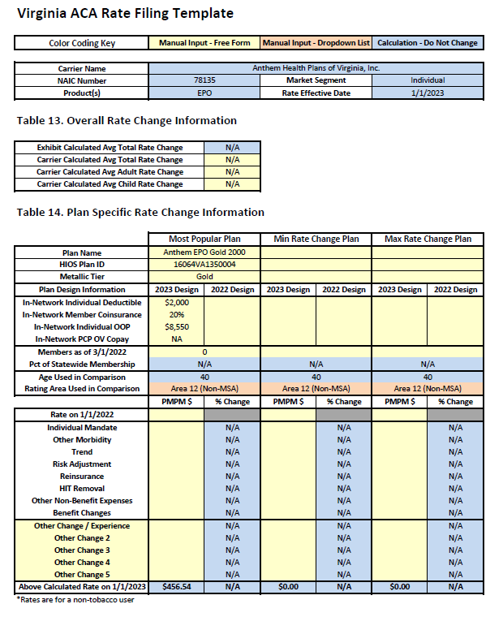
Anthem Health Plans of Virginia, Inc.
Individual
Presenter: Tim Connell, Director for Virginia

Slide 24
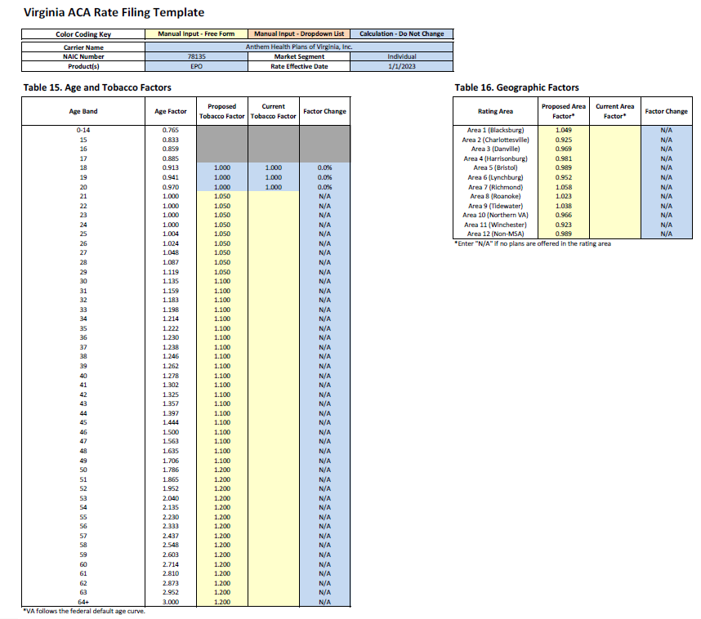

Slide 25
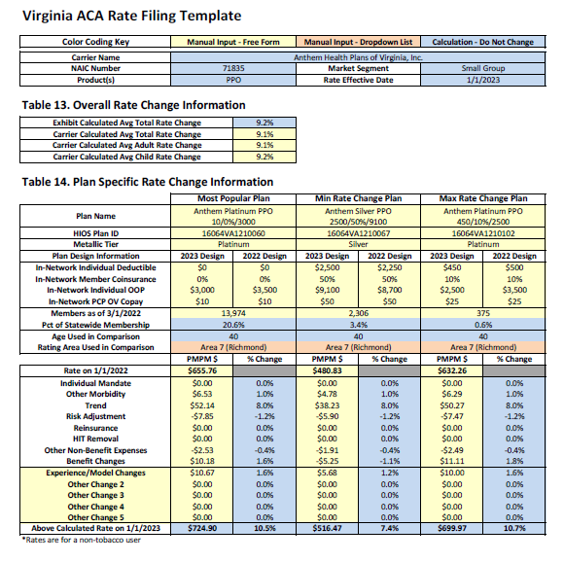
Anthem Health Plans of Virginia, Inc.
Small Group
Presenter: Tim Connell, Director for Virginia

Slide 26
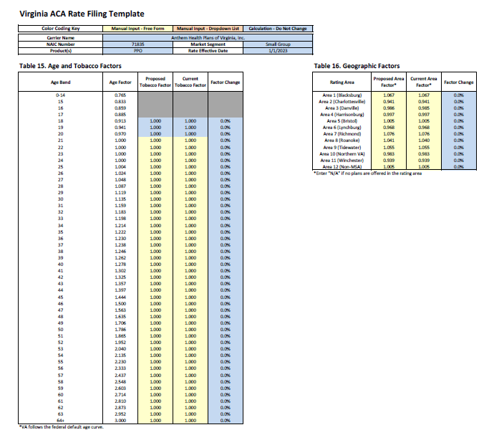

Slide 27
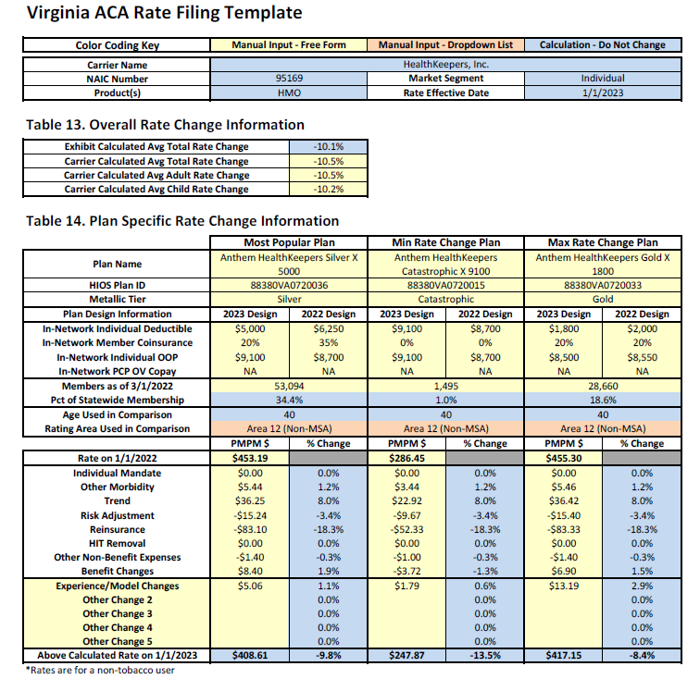
HealthKeepers, Inc.
Individual
Presenter: Tim Connell, Director for Virginia

Slide 28
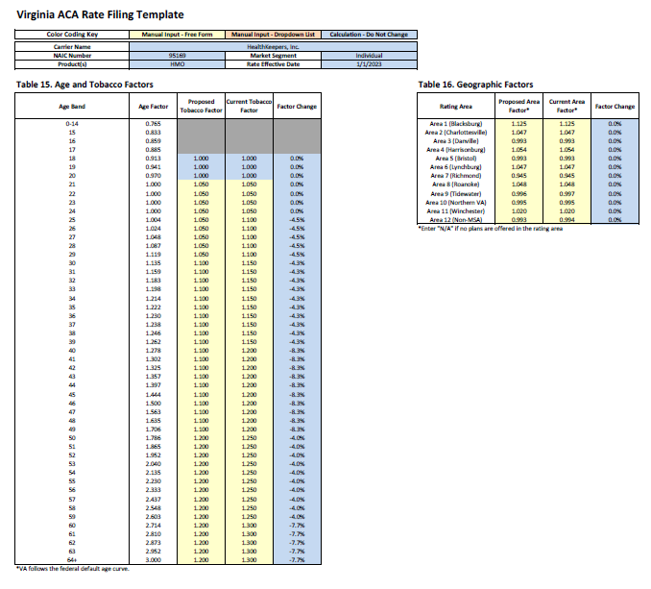

Slide 29
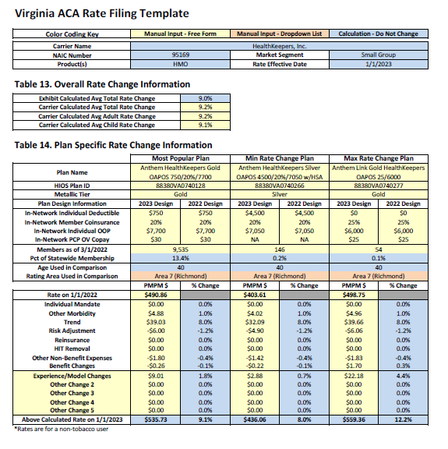
HealthKeepers, Inc.
Small Group
Presenter: Tim Connell, Director for Virginia

Slide 30
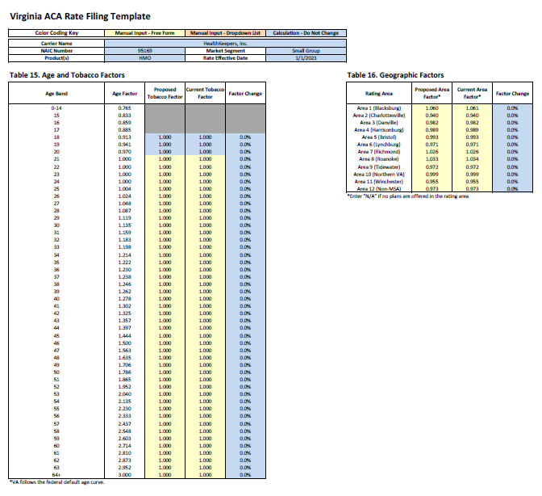

Slide 31
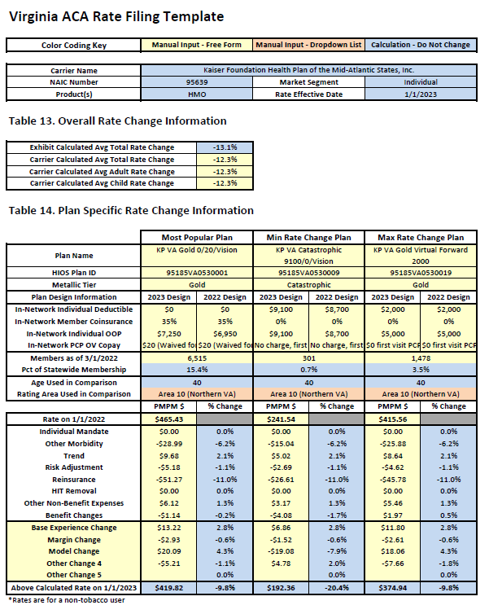
Kaiser Foundation Health Plan of the Mid-Atlantic States, Inc.
Individual
Presenter: James Chu, Director, Actuarial Services

Slide 32
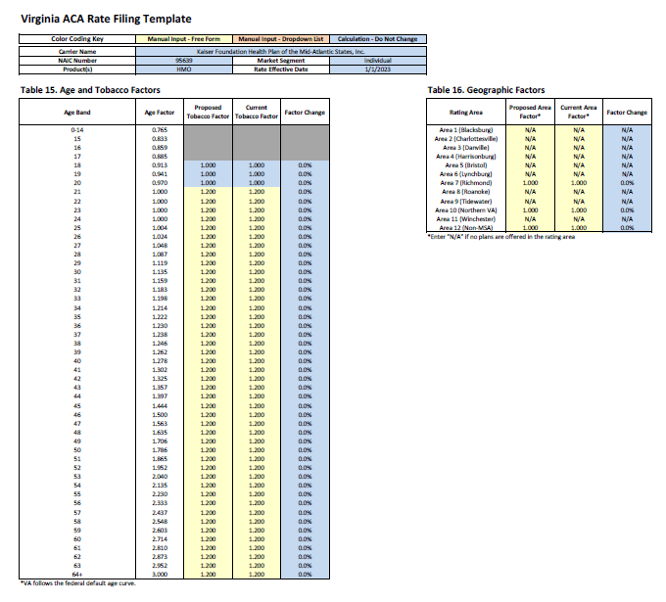

Slide 33
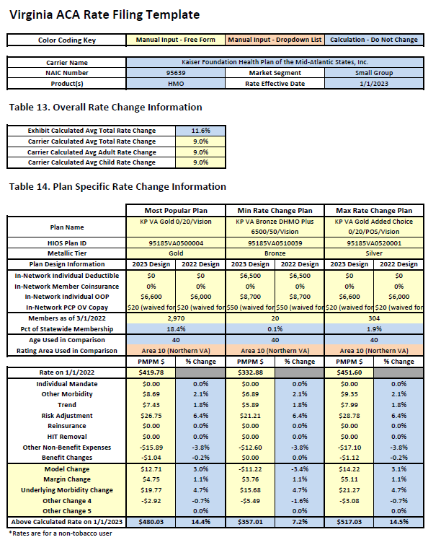
Kaiser Foundation Health Plan of the Mid-Atlantic States, Inc.
Small Group
Presenter: James Chu, Director, Actuarial Services

Slide 34
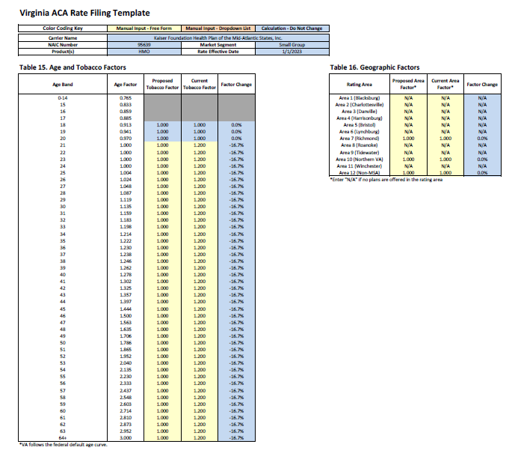

Slide 35
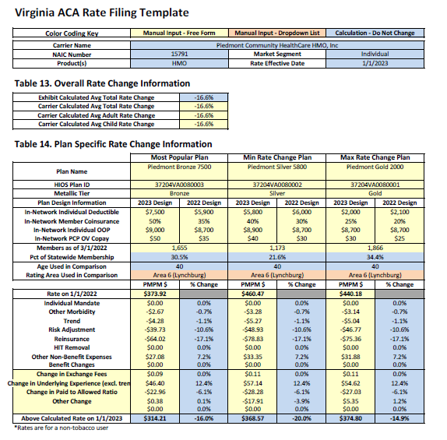
Piedmont Community Healthcare HMO, Inc.
Individual
Presenter: Lydia Tolman, FSA, MAAA, Senior Consulting Actuary with Wakely Consultants

Slide 36
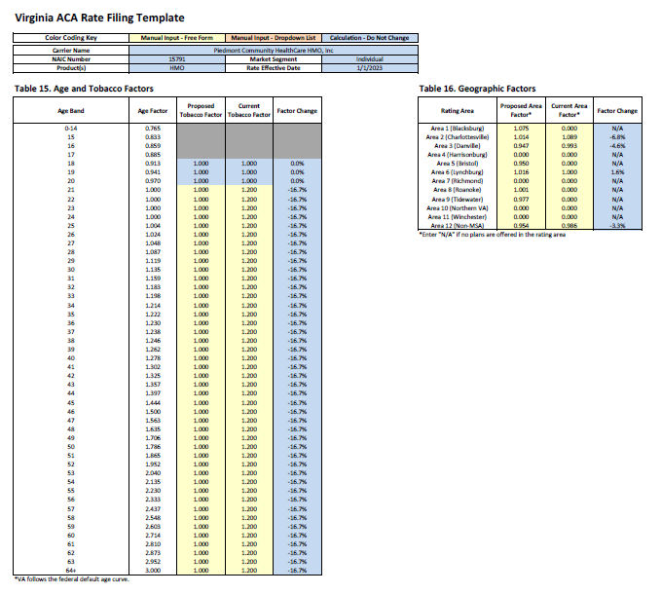

Slide 37
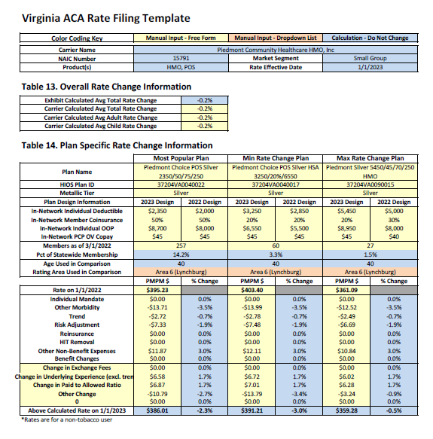
Piedmont Community Healthcare HMO, Inc.
Small Group
Presenter: Lydia Tolman, FSA, MAAA, Senior Consulting Actuary with Wakely Consultants

Slide 38
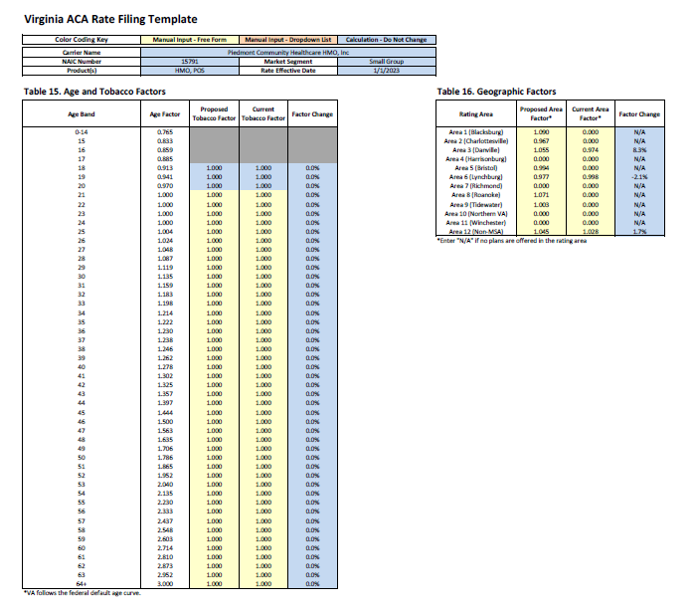

Slide 39
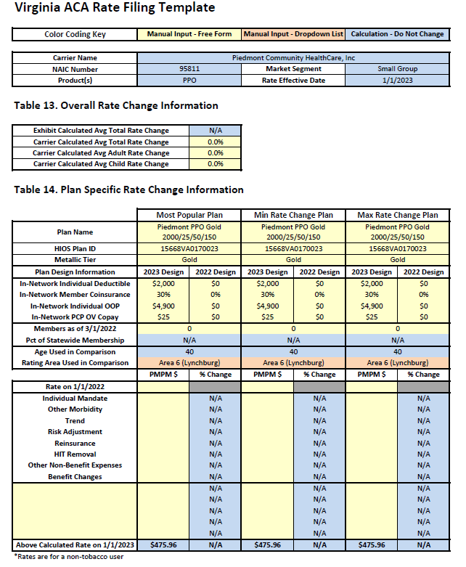
Piedmont Community Healthcare, Inc.
PPO Small Group
Presenter: Lydia Tolman, FSA, MAAA, Senior Consulting Actuary with Wakely Consultants

Slide 40
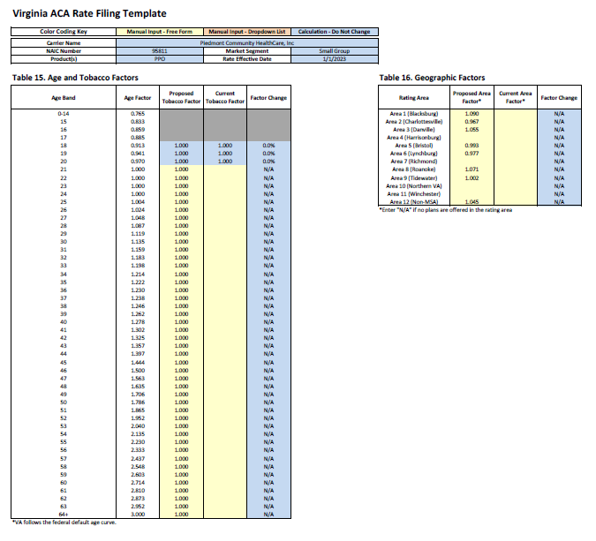

Slide 41
Non-Presenting Companies
Aetna Health, Inc.
Aetna Life Insurance Company
CareFirst BlueChoice, Inc.
Cigna Health and Life Insurance Company
Group Hospitalization & Medical Services, Inc.
Innovation Health Insurance Company
Innovation Health Plan, Inc.
Optima Health Insurance Company
Optima Health Plan
Optimum Choice, Inc.
Oscar Insurance Company
UnitedHealthcare Insurance Company
UnitedHealthcare of the Mid-Atlantic, Inc.
UnitedHealthcare of the River Valley, Inc.

Slide 42
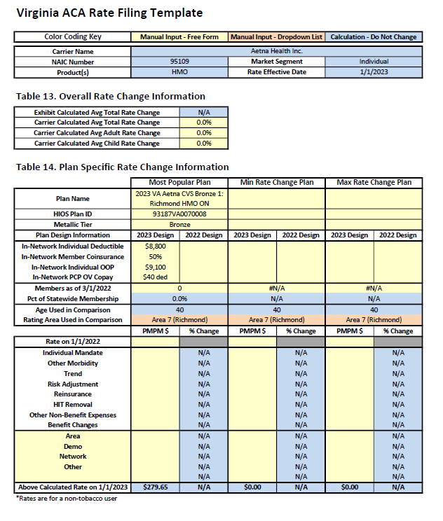
Aetna Health, Inc.
Individual

Slide 43
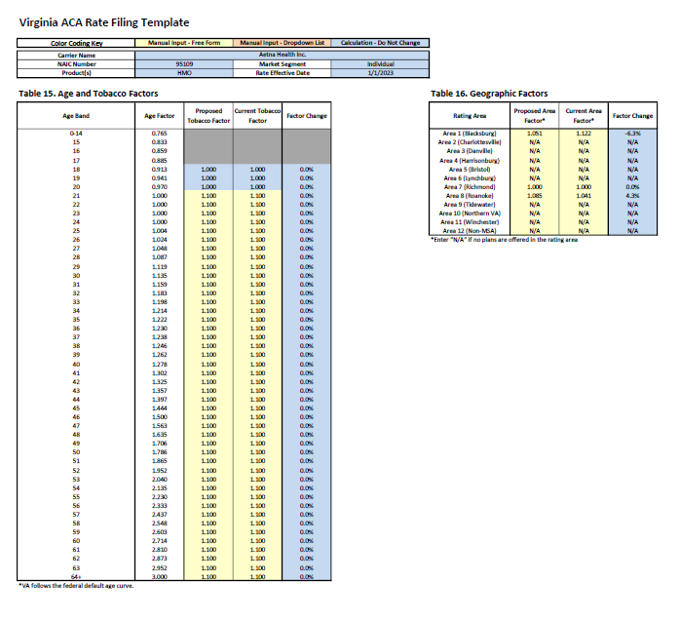

Slide 44
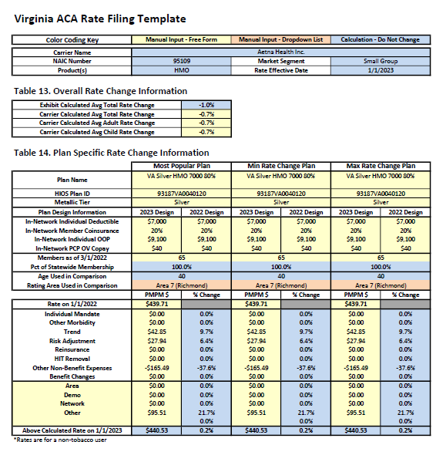
Aetna Health, Inc.
Small Group

Slide 45
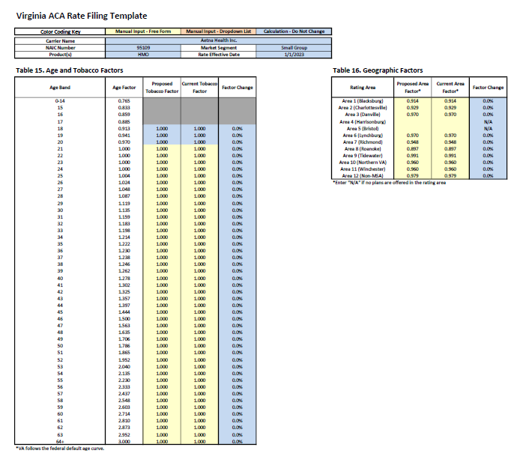

Slide 46
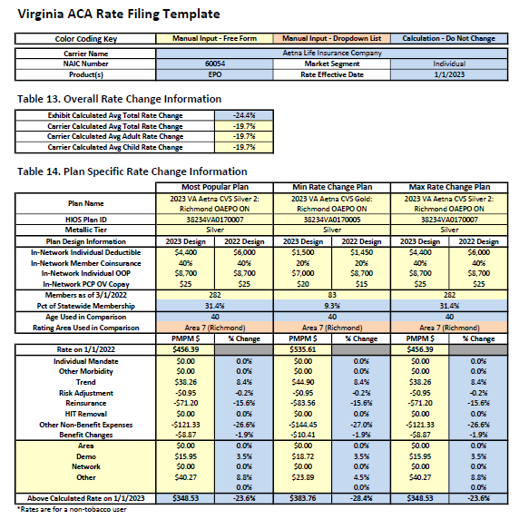
Aetna Life Insurance Company
Individual

Slide 47
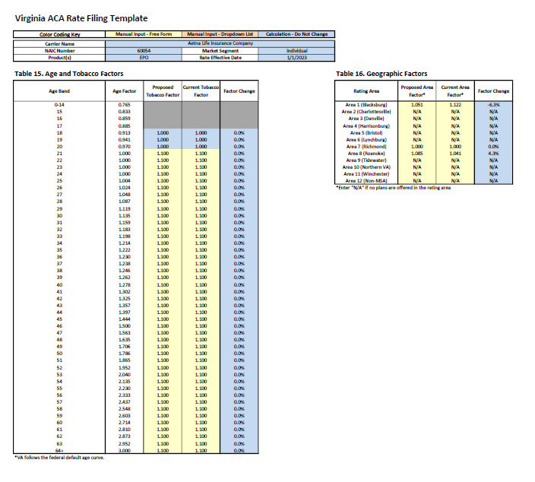

Slide 48
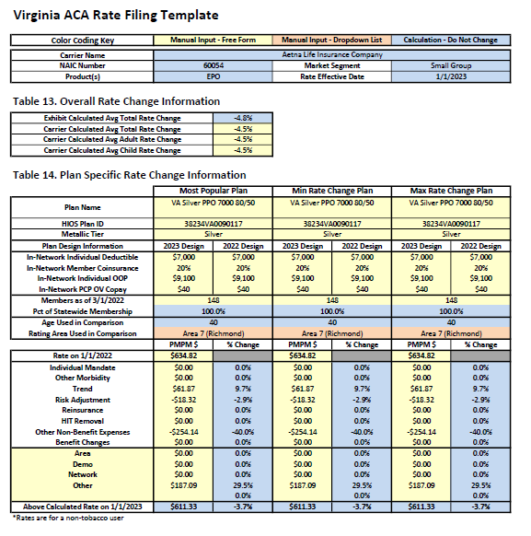
Aetna Life Insurance Company
Small Group

Slide 49
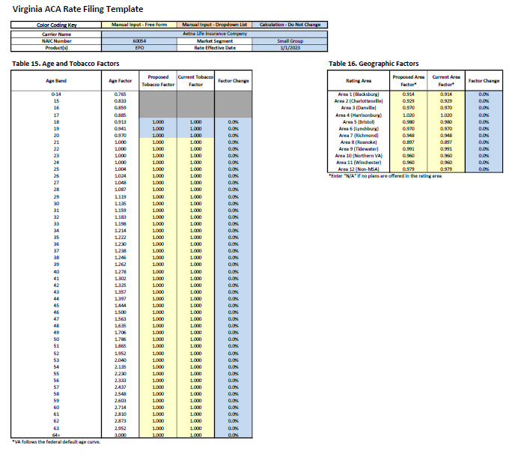

Slide 50
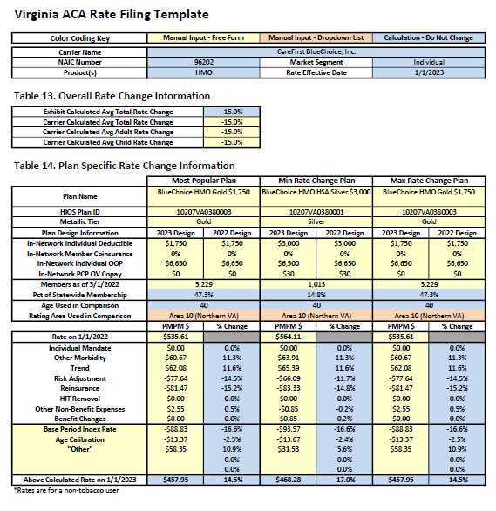
CareFirst BlueChoice, Inc.
Individual

Slide 51
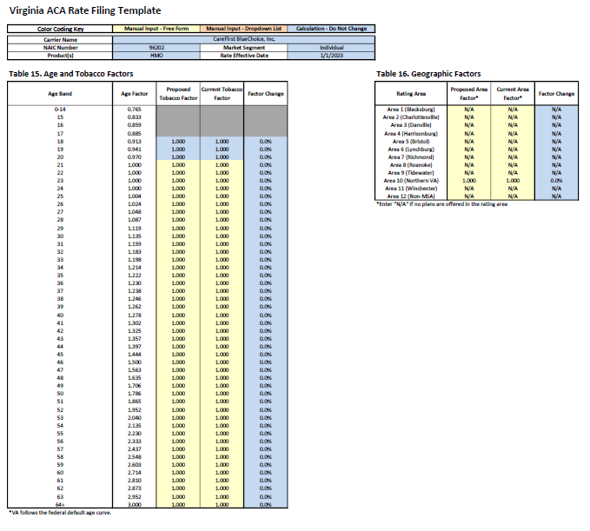

Slide 52
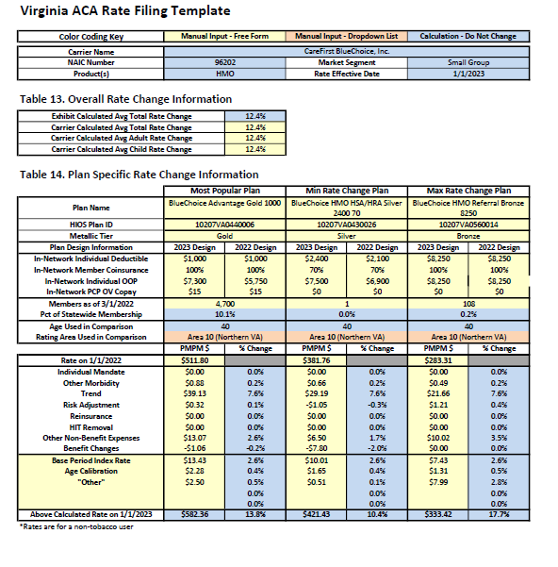
CareFirst BlueChoice, Inc.
Small Group

Slide 53
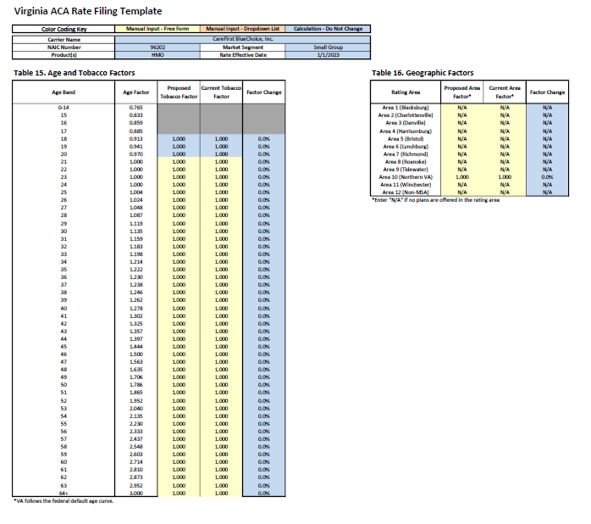

Slide 54
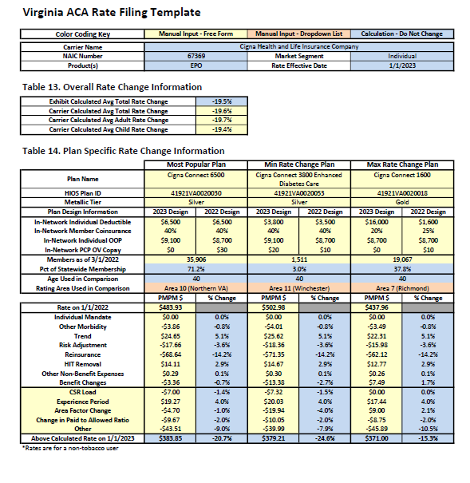
Cigna Health and Life Insurance Company
Individual

Slide 55
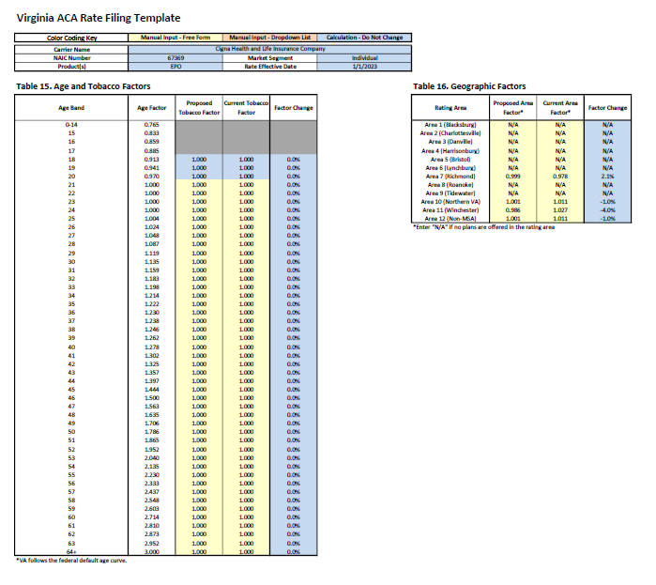

Slide 56
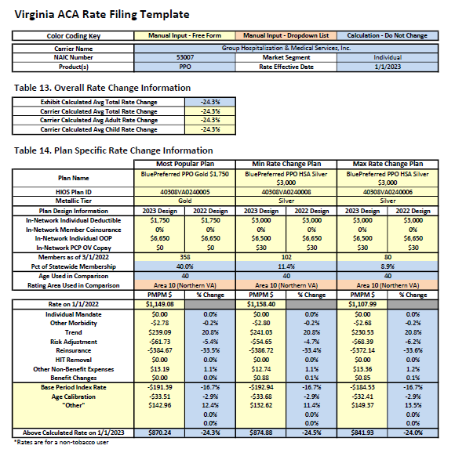
Group Hospitalization & Medical Services, Inc.
Individual

Slide 57
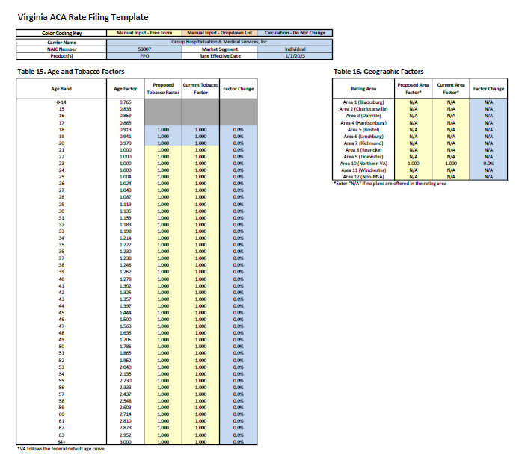

Slide 58
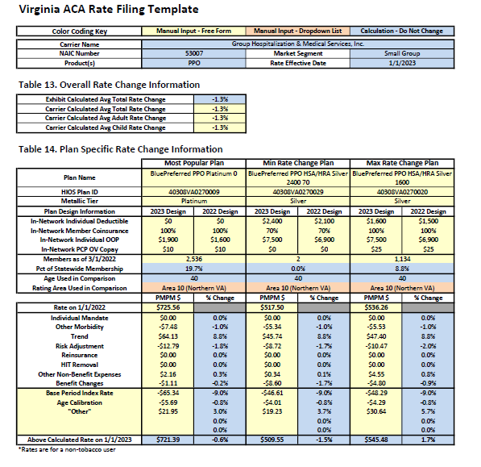
Group Hospitalization & Medical Services, Inc.
Small Group

Slide 59
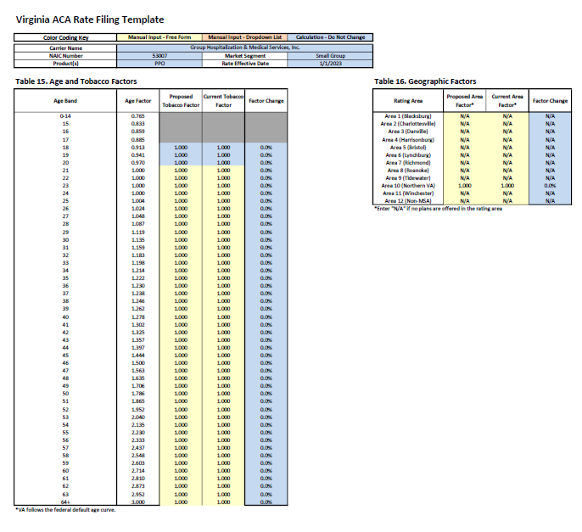

Slide 60
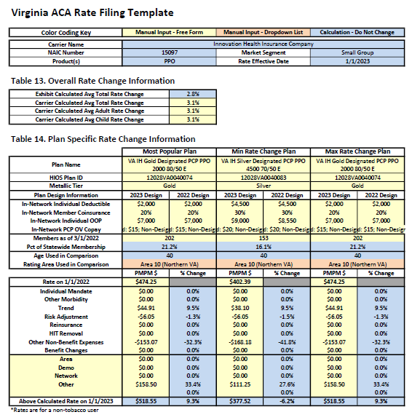
Innovation Health Insurance Company
Small Group

Slide 61
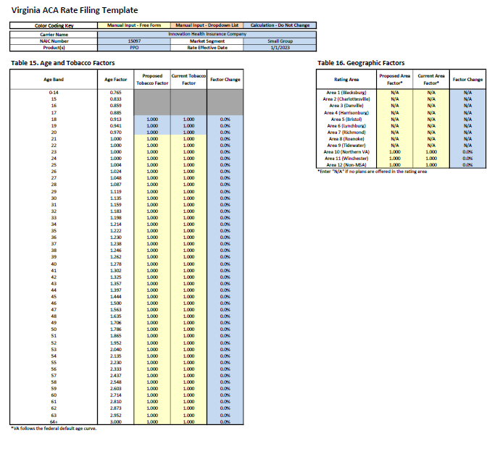

Slide 62
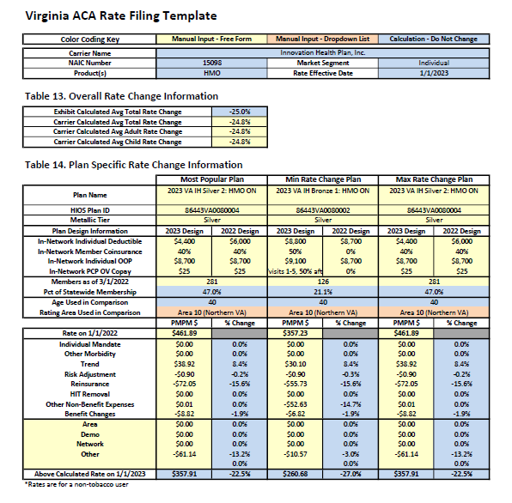
Innovation Health Plan, Inc.
Individual

Slide 63
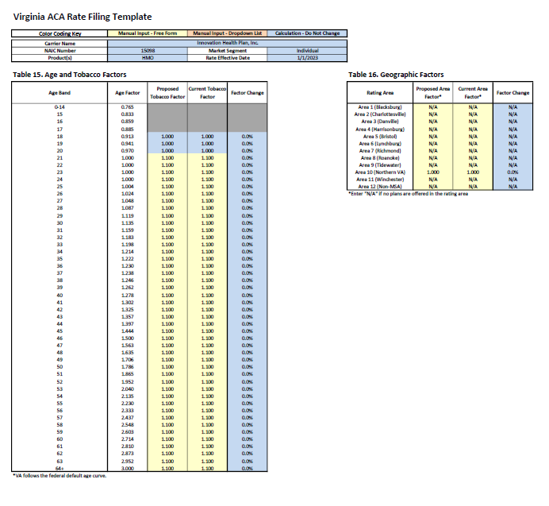

Slide 64
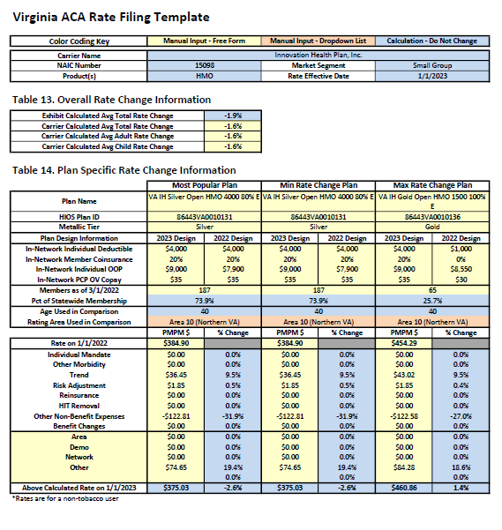
Innovation Health Plan, Inc.
Small group

Slide 65
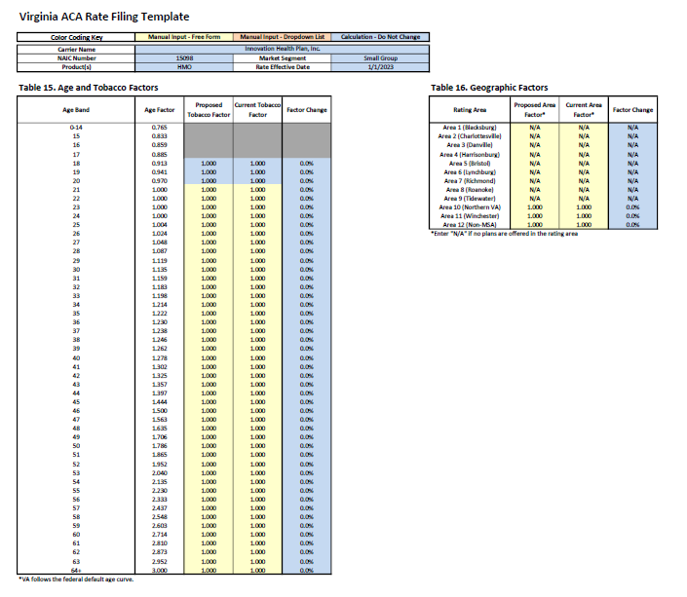

Slide 66
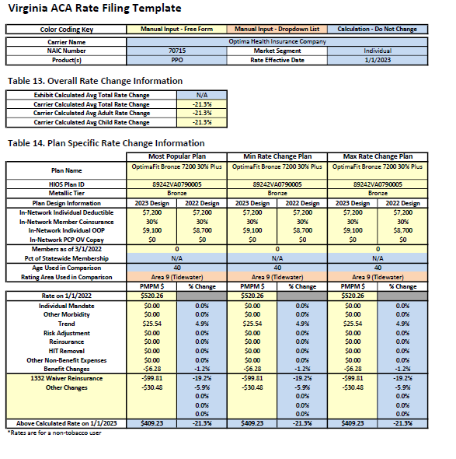
Optima Health Insurance Company
Individual

Slide 67
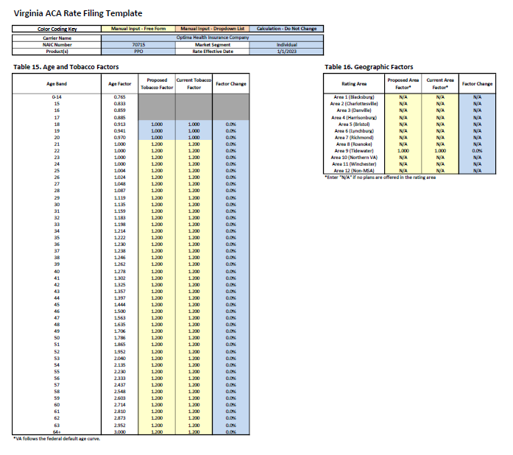

Slide 68
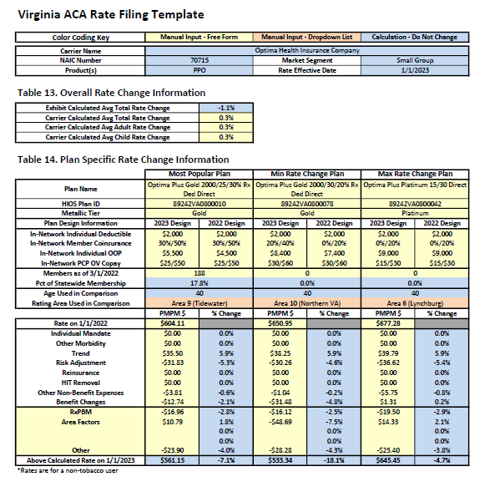
Optima Health Insurance Company
Small group

Slide 69
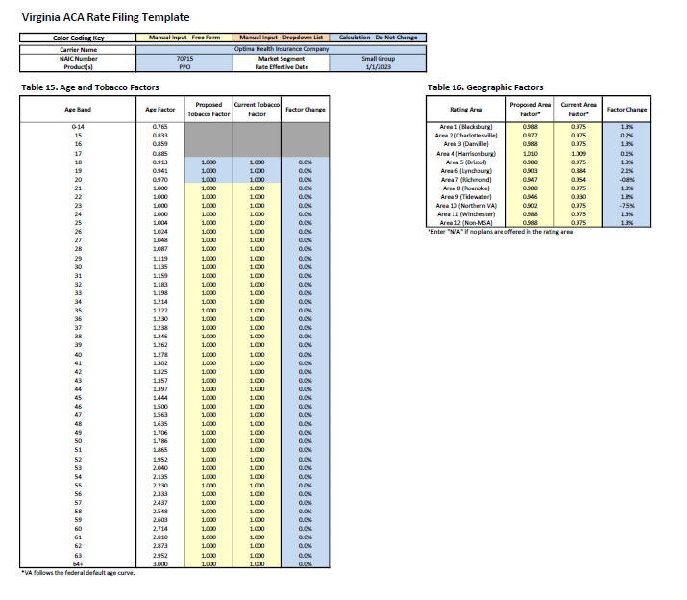

Slide 70
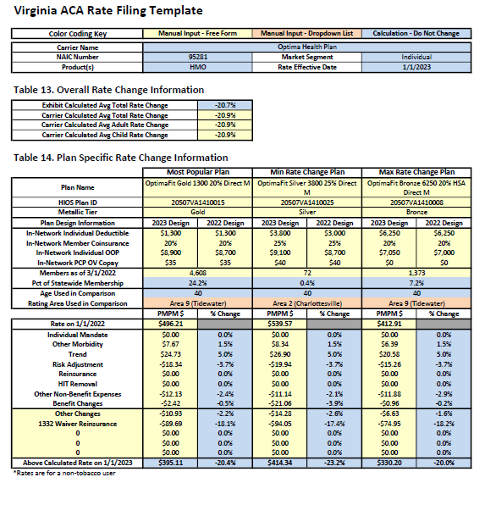
Optima Health Plan
Individual

Slide 71
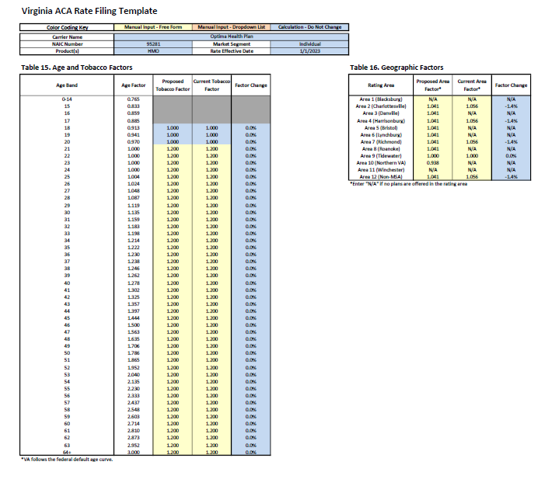

Slide 72

Optima Health Plan
Small group

Slide 73


Slide 74

Optimum Choice, Inc.
Individual

Slide 75


Slide 76

Optimum Choice, Inc.
Small Group

Slide 77


Slide 78

Oscar Insurance Company
Individual

Slide 79


Slide 80

UnitedHealthcare Insurance Company
Small Group

Slide 81


Slide 82

UnitedHealthcare of the Mid-Atlantic, Inc.
Small Group

Slide 83


Slide 84

UnitedHealthcare Plan of the River Valley, Inc.
Small Group

Slide 85


