Slide 1
Plan Year 2024 Virginia ACA Carrier Teleconference
Today’s topics include:
Important Dates
Virginia ACA Rate Filing Information
Mental Health Parity Compliance
Binder Filing Reminders
Commonwealth Health Reinsurance Program
Virginia Legislation
Virginia Health Benefit Exchange Updates

Slide 2
Bureau of Insurance & Health Benefit Exchange Presenters
David Shea, Health Actuary
David.Shea@scc.virginia.gov
Brant Lyons, Principal Insurance Market Examiner (Market Conduct)
Brant.Lyons@scc.virginia.gov
Sharon Holston, Manager, Plan Management & ACA Forms
Sharon.Holston@scc.virginia.gov
Brad Marsh, Insurance Policy Advisor
Bradley.Marsh@scc.virginia.gov
Julie Blauvelt, Deputy Commissioner (Life & Health)
Julie.Blauvelt@scc.virginia.gov
Toni Janoski, Deputy Director, Health Benefit Exchange
Toni.Janoski@scc.virginia.gov

Slide 3
Important Dates (2023)
April 1: SERFF public access suspended for health form, rate, and binder filings and revisions made on or after this date up to the BOI rate presentations
April 1: Deadline for submission of the Health Care Shared Savings – Annual Report
April 14: Form filing deadline for ALL ACA health carriers (excludes SADPs)
April 28: Form and rate filing deadline for carriers submitting SADPs to be exchange-certified
May 12: Binder filing deadline for carriers offering SADPs to be exchange-certified

Slide 4
Important Dates (2023)
May 19: Rate filing deadline for ALL ACA health carriers
May 19: Binder filing deadline for carriers offering individual and small group health insurance coverage inside or outside the exchange
July 14: Deadline for voluntary service area revisions and rate filing revisions; revisions after this date can be made based only at request of BOI
July 14: Deadline for voluntary changes to the Prescription Drug Template. Revisions after this date can be made based only at the request of the BOI
August: Rate presentations to the Commission (tentative date); SERFF public access restored
August 16: Deadline for data transfer to HBE

Slide 5
Virginia ACA Rate Filing Information
VA ACA Rate Filing Template Changes
DO NOT CHANGE, MOVE OR CREATE TABS
References to HIT removed
All entries related to QHP only – defrayed non-EHBs removed
Additional ACA Rate Filing Information
Elimination of tobacco surcharge

Slide 6
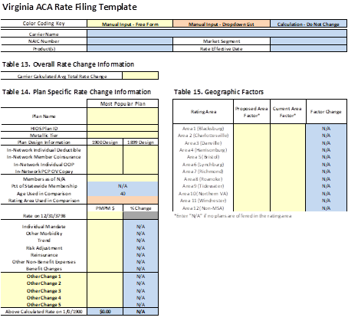
Virginia ACA Rate Filing Information (cont.)
VA ACA Rate Filing Template Changes (cont.)
Reformatted Rate Presentation page

Slide 7
Mental Health Parity (MHPAEA) Compliance
Virginia’s MHPAEA Self-Compliance Tool continues to be available on the BOI website.
Virginia’s QTL/Financial Requirement Guidance Document continues to be available on the BOI website.
Both can be found under “Life & Health – Mental Health/Substance Use Disorder Benefits Parity.”

Slide 8
Mental Health Parity (MHPAEA) Compliance (cont.)
Section 38.2-3412.1 G of the Code – Public Report issued each November
To date, the report has included information regarding denied claims, complaints, appeals, and network adequacy.
Beginning this November, the report will also include a summary of all NQTL comparative analyses requested by the BOI during the reporting period, to include:
If the analyses were accepted as compliant, rejected as noncompliant, or in process of review.
Corrective actions if noncompliant.

Slide 9
Mental Health Parity (MHPAEA) Compliance (cont.)
Additions to MHPAEA Forms Checklist
Describe which independent standards were used to define mental health conditions, substance use disorders, and medical/surgical conditions and how these standards and definitions are consistent with applicable state law.
Describe how the issuer determines that services and items are mental health benefits, substance use disorder benefits, or medical/surgical benefits, particularly for services and items that could be for multiple types of benefits (e.g., occupational therapy, nutritional counseling).

Slide 10
Mental Health Parity (MHPAEA) Compliance (cont.)
Additions to MHPAEA Forms Checklist (cont.)
The issuer shall provide a list of all NQTLs imposed upon mental health or substance use disorder benefits within each classification of benefits (or applicable sub-classification).
The issuer shall provide an attestation that for each NQTL imposed on MH/SUD benefits, in each classification the limitation is imposed, the issuer has performed an analysis that contains the required 5 steps.
The analyses must be available upon request.
NOTE: Policy exclusions, such as certain MH/SUD treatments that are not covered, are NQTLs.

Slide 11
Mental Health Parity (MHPAEA) Compliance (cont.)
Additions to MHPAEA Forms Checklist (cont.)
The certification at the end is more specific – financial requirement/QTL testing, NQTL analyses performed and available.
In addition, the issuer shall provide a certification from an actuary that an actuarial cost model was built to test each financial requirement and quantitative treatment limitation. An issuer shall use appropriate and sufficient data to perform the analysis in compliance with applicable Actuarial Standards of Practice. Please attach this certification under the Supporting Documentation tab of the Form Filing.

Slide 12
Binder Filing Reminders (2023 dates)
May 12th - binder filing deadline for SADPs
May 12^{th -} binder filing deadline for any carrier who wants to take advantage of the early bird transfer
May 19th – binder filing deadline for Individual and Small Group coverage inside and outside the exchange.
May 19th – Deadline for submission of Material Change Filing to BOI’s Financial Regulations Department and Virginia Department of Health for service area expansions in the individual and small group markets.
Carriers should use the Plan Validation Workspace in the HIOS Marketplace Plan Management System (MPMS) prior to submission in the binder.

Slide 13
Binder Filing Reminders (cont.)
Plan Year 2024 - Transition to a State-Based Exchange
The Exchange is required to implement a dual SBE-FP and SBE QHP Certification process
Binders will be transferred to CCIIO as an SBE-FP until VA and CCIIO mutually agree on VA’s readiness to be an SBE for the upcoming Open Enrollment – this will occur the first week of August.
Updated: URLs must be submitted in the MPMS Module in HIOS, and under Supporting Documentation of the binders.
The federal ID Crosswalk must be submitted in Plan Management Community, and under Supporting Documentation of the binders.

Slide 14
Binder Filing Reminders (cont.)
Following the date of the initial transfer, June 14, 2023 a carrier subject to this date can only make voluntary changes to the information in any form, rate or binder filing if the BOI allows the change. The carrier must make the request and submit the proposed revision as a Note to Reviewer in SERFF and wait for the BOI’s response prior to submitting the voluntary change in the filing. This does not apply to BOI requested changes.
The Virginia Plan Schedule Comparison is included as a tab (tab IX) on the Virginia ACA Rate Filing Template for all individual and small group plans inside and outside the exchange.
The form number of the schedule of benefits associated with each plan should be entered in Column E of tab IX.
SADP carriers must complete the Virginia Plan Schedule Comparison and attach it under the Supporting Documentation tab in each binder.

Slide 15
Binder Filing Reminders (cont.)
The Associate Schedule Items (ASI) tab in the binder must include all forms and rates filed for each plan. Each form must include a valid link to the actual form submission. Each plan must include a link to a valid rate submission.
All tabs must be completed upon initial submission of the binders.
The VA Rate Filing Template should be attached under the Supporting Documentation tab in each binder. The rate sheet that is attached to the Rate/Rule Schedule in the rate filing should be attached under the ASI tab and linked to the corresponding rate filing for each plan.
The URRT submitted in the rate filing should be attached to the ASI tab with a link to the rate filing. (This is not required for SADP filings.)
For carriers who use a different filing instance for rates and are not able to complete the rate portion of the ASI tab, a document presenting the same rate information that is required, including the URRT, and the SERFF tracking number of the Rate Filing, must be submitted under the Supporting Documentation tab in the binder and must be kept updated.

Slide 16
Binder Filing Reminders (cont.)
Carriers must update all related forms, rates and binder filings if changes are made to one of these filings. Carriers must inform binder reviewers when items are updated on the ASI tab, such as the URRT.
Reminder: Carriers who include coverage for elective abortion for QHPs on the Exchange should report such coverage as an Addition to EHB. Carriers must submit a plan for segregation of funds that must be approved prior to implementation and must file an Annual Report of Segregated Premiums with its Annual Statement.
Plan and plan variation marketing names must include correct information, without omission of material fact, and must not include any misleading content. Plan marketing names will be required to be limited to the name of the plan (which may include the metal level, cost sharing variation, and HSA), and the deductible amount, which must be labeled as such. Any other benefit information will not be allowed in the plan marketing name with the exception of “vision” or “dental.”
The Virginia Exchange will follow FFE instructions in the 2024 final annual letter to issuers in the FFE, including instructions about standardized and non-standardized plans.

Slide 17
Binder Filing Reminders (cont.)
Network Adequacy/ECP/QIS Reviews:
Provide a response to all applicable items on the Supporting Documentation tab. If a category/slot does not apply to the carrier, a reason should be included in the comment section. Using N/A, Bypass or leaving the item blank is not acceptable.
Be sure to attach the correct documentation under each category/slot
For Plan Year 2024 binders, if the carrier has an Accreditation Approval Letter but does not have a signed Certificate of Quality Assurance, the letter will be sufficient.

Slide 18
Form Filing Reminders
New for Plan Year 2024: CMS will review forms in the Individual, small group and large group markets for compliance with 4 areas of the CAA/NSA:
Surprise billing – non-emergency services
Surprise billing – air ambulance
Continuity of care
Emergency services – prohibition on prior authorization and cost-sharing restrictions
Form submissions to CMS must be made at the product level. This may result in more than one SERFF filing per market. The BOI has not required carriers to submit different product forms in separate SERFF submissions in the past; therefore, when filing with the BOI, carriers will have the option to file the same way they have been (to include multiple product types in the same filing), or file in the same manner as CMS requires.
New for Large Group Form Filings – Carriers should file complete documents for policies, certificates, or EOCs. We will no longer accept multiple forms or sections intended to make up one policy, certificate or evidence of coverage, except that any schedules, amendments, or riders may be separate.

Slide 19
Commonwealth Health Reinsurance Program
Virginia’s application to establish the Commonwealth Health Reinsurance Program (CHRP) under section 1332 of the ACA was approved on May 18, 2022 to begin in plan year 2023.
BOI plans to publish CHRP Parameters for PY 2024 by May 1, 2023 in accordance with statute.
Parameters include attachment point, reinsurance cap, and coinsurance rate
Carriers must submit data on enrollment and costs by March 1 each year to facilitate meeting the statutory deadline for publishing parameters
Quarterly carrier reports on claims cost that exceed the attachment point will be due 45 days after the end of each quarter
Carriers must file the Reinsurance Care Management Protocol Assessment as part of a carrier’s individual health insurance coverage rate filing for plan year 2024.
Demonstrate efforts to manage the claims of higher-cost individuals
Post-award forum to be held June 2023

Slide 20
Proposed Reinsurance Claim Submission and Payment Schedule
September 2023 - First EDGE report should be received
Federal EDGE report provides summary information at the carrier level on claims within the reinsurance reimbursement band
BOI will work with carriers on discrepancies between EDGE and Quarterly Carrier claims reports
4/30/2024 – Claims finalized in EDGE
5/15/2024 – Carriers submit 2023 reinsurance claims for reimbursement
Carriers will submit final requests for reinsurance payments on the BOI Quarterly Carrier Claim Report template
5/31/2024 – Final EDGE report to BOI
8/1/2024 – BOI issues initial 2023 payment determination to carriers
8/31/2024 – BOI issues final 2023 payment determination to carriers
11/15/2024 – deadline for payments to be issued to carriers

Slide 21
Virginia Legislation
Review legislation for forms and rates development
Forms checklists will provide some direction
HB 1375/SB 1011 – Tobacco Surcharge eliminated as an adjustment factor for 2024 rates and beyond. Will ask for carriers to show impact of this change at rate presentations.
HB 2198/SB 1399 – Requires BOI to select a new essential health benefits benchmark plan for the 2025 plan year that includes coverage for prosthetic devices and components and formula and enteral nutrition products as medicine.
HB 2216/SB 1347 – Requires carriers to cover emergency services by mobile crisis response teams and residential crisis stabilization units. BOI is forming a work group and will submit a report.
HB 2354 – Continuity of Care provisions.
SB 1003 – Required coverage for hearing aids; state defrayal of costs – QHPs on and off-Exchange must not include costs for this coverage in rates.

Slide 22
Virginia Health Benefit Exchange Transition Update
The SCC granted a nine-year contract to GetInsured for Virginia’s platform and consumer assistance center in the Fall of 2022. The platform and consumer assistance center will be live for Plan Year 2024 Open Enrollment.
GetInsured successfully transitioned NV, NJ, and PA from the FFE to their own state-based platforms. GetInsured operates in 7 of the 18 SBEs nationwide.
Currently, GetInsured and the HBE are holding weekly 1:1 meetings with each on Exchange health and dental carrier as well as holding monthly carrier town hall meetings. The HBE is also gathering questions from carriers through its dedicated carrier email (ExchangeCarriers@scc.virginia.gov) and responding weekly via carrier FAQs. We welcome your questions regarding transition via this box.
Virginia’s platform and consumer assistance center will be integrated and will be staffed by customer service representatives dedicated only to Virginia consumers, carriers, agents, navigators, and assisters.

Slide 23
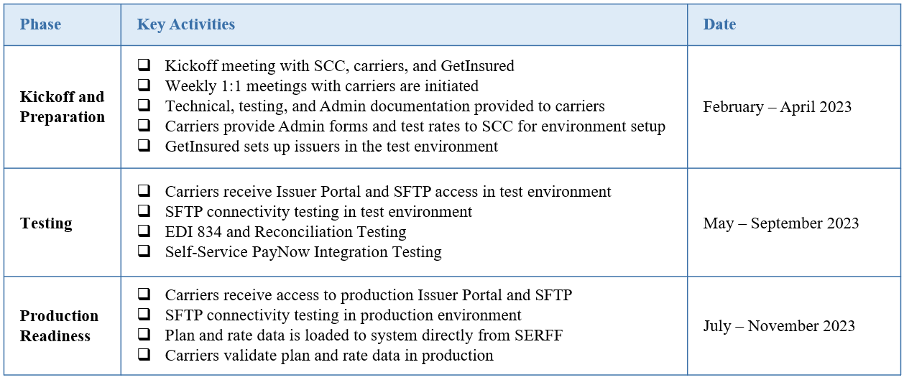
Virginia Health Benefit Exchange Carrier Onboarding

Slide 24
Virginia Health Benefit Exchange Contacts
Keven Patchett, Exchange Director
Toni Janoski, Deputy Director of Operations and Finance
Susan McCleary, Deputy Director of Governance & Program Management
Holly Mortlock, Chief of Government Affairs and Policy
Contact:
ExchangeCarriers@scc.virginia.gov
833-740-1364 or 804-371-1532
Questions? Interested in receiving HBE’s weekly FAQs and town hall invitations? Send your name & email to the above address.

Slide 25
ACA Form/Rate Filing Questions
ACAFilingInfo@scc.virginia.gov

