Slide 1

Arbitration Process for Balance Billing Disputes
Presentation by the Bureau of Insurance, 12/16/2021

Slide 2
Overview of today’s presentation:
Arbitrator Qualification, Application, and Duties
Arbitration Process
Overview of Complete Timeline
Notification to Parties
Arbitration Decision
Claim Bundling
Appeal
Texas Comparison

Slide 3
Appointing Arbitrators
Required Qualifications:
  Any professional license that the arbitrator has is in good standing;
  Training in the principles of arbitration by an organization recognized by the Commission;
  Experience in matters related to medical or health care services;
  Completion of any training made available to the applicants by the Commission;
    Arbitrators must complete and submit a certification of training to the BBVAARBCERT@scc.virginia.gov within 60 days of the date of this training.
  Experience in arbitration;
  Any other information deemed relevant by the Commission.

Slide 4

What to provide as part of the arbitrator application:
Number of years of experience in arbitration;
Number of years of experience in practice of medicine, law or other administration of health care matters;
Names of health carriers for which arbitration has been conducted by arbitrator;
Memberships in associations related to health care or arbitration and any related training;
List of specific areas of expertise;
Total fee charged for arbitration;
Any other information deemed relevant by the Commission.

Slide 5
Arbitrators must disclose conflicts of interest.
A conflict of interest may include:
Current or recent ownership or employment with any health carrier;
Current or recent ownership or employment with a physician, health care provider, the health care provider’s medical group, or the independent practice association;
Current or recent ownership or employment at the health care facility where services were provided;
Current or recent ownership por employment with the developer or manufacturer of the principal drug, device, procedure or therapy;
Having a material professional, familial, or financial conflict of interest with a party to the arbitration;
A relationship with the covered person or his/her authorized representative.
Arbitrator must reject the appointment if any of the above exist.

Slide 6
Arbitrator Duties
Ensure arbitrations are conducted within the specified timeframe.
Ensure required notices are provided in a timely manner.
Ensure records are maintained.
Provide the Completed Arbitration Decision Form to BBVA@scc.virginia.gov.

Slide 7
Arbitration Process - Overview
Complete Arbitration Timeline
Notification to Parties
Decision
Bundled Claims
Appeal

Slide 8

Complete Arbitration Process –
Timeline
 |  |  | Example
Step 1 |  | Out-of-network provider submits clean claim to carrier/payer. | 1/15/21
Step 2 | Within 30 days of Step 1 date | Carrier/payer pays or offers to pay out-of-network provider. | 1/31/21
Step 3 | Within 30 days of Step 2 date | Provider may dispute payment or payment offer by notifying carrier/payer. | 2/15/21
Step 3 continued | Ends 30 days after Step 2 date | Parties are engaged in good faith negotiation. | 3/2/21
Step 4 | Within 10 days of the end of Step 3 continued | Carrier/payer or provider can request arbitration by sending this form to the SCC and to the non-initiating party. Initiating party must include their final offer with request. | 3/12/21
Step 5 | Within 10 business days of Step 4 date | Nondisclosure agreement signed by the initiating and non-initiating parties. The parties decide on the agreement to sign. | 3/26/21
Step 6 | Within 20 days of Step 4 date | Arbitrator is chosen. Commission notifies initiating and non-initiating parties of chosen arbitrator and copies chosen arbitrator. | 4/1/21
Step 7 | Within 30 days of Step 4 date | Both parties must make written submissions in support of final offer. | 4/11/21
Step 8 | Within 10 days of Step 6 date | Parties each pay arbitrator their half of the applicable fee. | 4/11/21
Step 9 | Within 15 days of Step 7 date | Arbitrator issues decision. | 4/26/21
Step 10 | Within 10 days of Step 9 date | Claim payment is made. | 5/6/21

Slide 9
Initiating the Arbitration Process
If a dispute is not resolved in good faith negotiation, the health carrier or provider may initiate arbitration by providing the Notice of Intent to Arbitrate form to the Commission and the non-initiating party within 10 calendar days following completion of the good faith negotiation period.

Slide 10
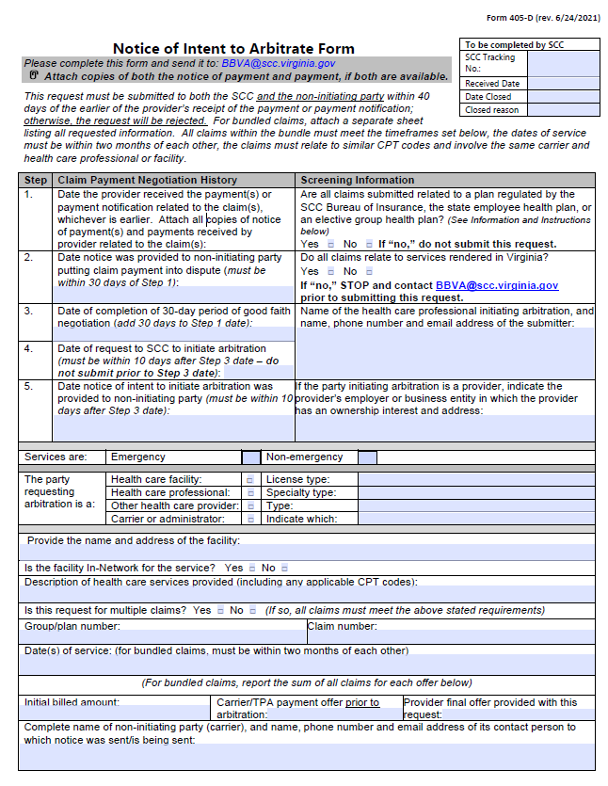
Notice of Intent to Arbitrate (NIA) Form

Slide 11
Notification email will include
The chosen arbitrator.
A copy of the NIA Form.
The Arbitrator Decision Form.
The total arbitration fee.
The deadline to pay the arbitration fee.
Any determination of ineligible claims within a bundle.
A reminder to execute the NDA.
A reminder for both parties to submit in writing what the arbitrator should consider.
A timeline reminder.

Slide 12

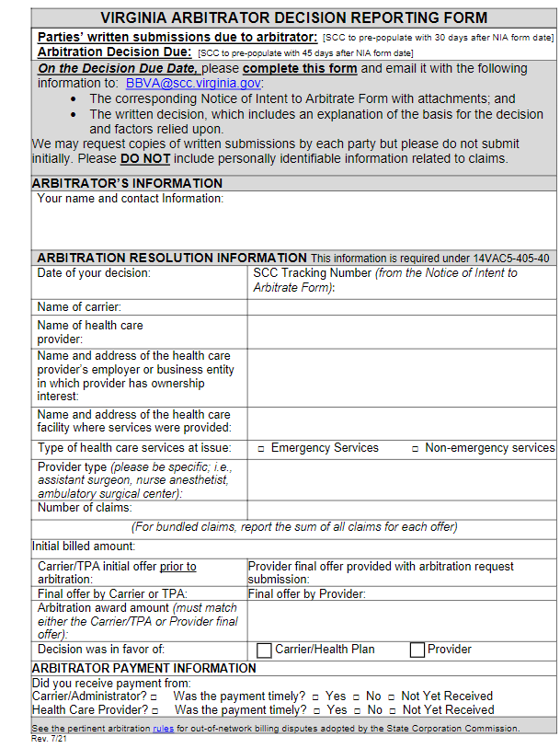
Virginia Arbitrator Decision Reporting Form

Slide 13
Arbitration Decision: Making a Determination
What MUST be considered:
The evidence and methodology submitted by the parties to assert their final offer is reasonable.
Patient characteristics and the circumstances and complexity of the case, including time and place of service and type of facility.
What MAY be considered:
Other information the party believes is relevant, and information requested by the arbitrator, but only as part of the original submission to the arbitrator.
Arbitrator may request the parties to indicate their argument as to whether Virginia's commercially reasonable data set should be used.
  Data sets can only be used if provided in the parties’ original written submission.

Slide 14
Data Sets
The Commission was required by Section 38.2-3445.03 of the Code of Virginia to contract with Virginia Health Information to establish the Virginia data set to assist in determining commercially reasonable payments and resolving payment disputes for out-of-network services.
The data set provides combined median in- and out-of-network allowed amounts and median billed charges for specific services by geographic area in Virginia.
When sufficient data exists, the data set shows the amounts by geographic rating area (commonly used by carriers) and by health planning region (commonly used by providers).

Slide 15
Using Data Sets in Arbitration Decision
The data set can be used to provide carriers, providers, and arbitrators with data to assist in determining commercially reasonable payments and resolving payment disputes.
The data set currently shows a combined in and out of network median allowed amount.
The original data set is based upon the most recently available full calendar year of claims data.
The data set for each subsequent year shall be adjusted by applying the Consumer Price Index-Medical Component as published by the Bureau of Labor Statistics of the U.S. Department of Labor to the previous year's data set.
Virginia does not require that the data set be considered in making the arbitration decision.
If the parties do not submit information from the data set as part of their written submission, the arbitrator cannot use the data set in the decision.

Slide 16
Required Arbitrator Decision Submission
Provide to BBVA and Parties to Arbitration:
The completed ADR form.
The corresponding NIA form, with attachments.
A copy of the written decision, that includes an explanation of the basis for the decision and factors relied upon.
Do not provide the written submissions of each party to BBVA unless requested.
Provide Only to Parties to Arbitration:
The arbitrator should send a second email to both parties with each parties’ original written submission and the completed ADR form.

Slide 17
What should be included in arbitrator’s written decision:
The requirement for the arbitrator to choose one of the party’s final offer;
The factors that must and may be considered in the decision, indicating how each factor weighed into the decision;
The factors submitted by each party to support their offers, discussing how the information did or did not support the arbitrator's decision.
A discussion of why the selected offer is a commercially reasonable amount based on payments for similar services provided in a similar geographic area;
  If Virginia’s commercially reasonable data set was not used in the arbitrator’s decision, an explanation of why not, and a reference to the specific data that was used, including information about the circumstances of the data, such as whether similar patient characteristics and circumstances existed, services were rendered in a similar geographic area, and similar services were provided; and
  Any suggestions to the parties about how they can improve their written submissions.

Slide 18
Bundled Claims
Virginia does not have a limit on the number or dollar amount of claims.
Claims must have occurred within 2 months of each other and be related to the same health care professional (not a provider group), same carrier (not carrier group), and the same or similar CPT code.
The Bureau will rely on the parties or the arbitrator to verify that claims are correctly bundled, especially as far as similar CPT codes.
Bundled claim fees listed for arbitrators are the fee for the entire bundle - not per claim.
Arbitrator should verify they have indicated their fee correctly.
Virginia does not have a mechanism for a separate per claim fee on bundled cases.

Slide 19
Right to Appeal
Within 30 calendar days of receipt of the arbitrator’s decision, either party may appeal if:
The decision was substantially influenced by corruption, fraud, or other undue means;
There was evident partiality, corruption, or misconduct prejudicing the rights of any party;
The arbitrator exceeded his/her powers; or
The arbitrator conducted the proceeding contrary to the requirements of Virginia laws and regulations.

Slide 20
Virginia and Texas
How the processes compare

Slide 21
How are Virginia and Texas similar?
 | Virginia | Texas
How are arbitration decisions made? | Arbitrator reviews each final offer amount to determine which represents the more reasonable amount. One side wins. | The total bill is reviewed. The decision is based on which side is closest to the reasonable amount. One side wins.
Is consumer action required to start the arbitration process? | No | No
What qualifications are required for arbitrators? | Arbitrators must hold a professional license in good standing, arbitration training, medical experience, training by the Commission, arbitration experience, and not have conflicts within the health care industry and any other relevant information. | Arbitrators must be experienced in contract and insurance laws, and not have conflicts within the health care industry.
What information is considered? | Consideration of the evidence and methodology in each party’s submission, case complexity, patient circumstances, type of facility, time and place of service and any other relevant information submitted by either party. | The arbitrator must consider 10 factors. Factors include using information from the selected benchmarking database to determine the 80th percentile of providers' billed charges and the 50th percentile of health plans' payments for the same or similar services in that area.
How much time is allotted for arbitration? | The arbitrator must deliver a decision 15 days of receiving the written submissions of the parties. | 51 days. This includes a 30-day informal teleconference.
Are bundled claims allowed? | Yes, as long as the claims are related and occurred within 2 months of each other. | Yes, multiple claims can be submitted, totaling up to $5000 with the same plan in a single arbitration request.
Where can I find more information? | BOI webpage Virginia SCC - Bureau of Insurance or email to: BBVA@SCC.virginia.gov | Balance billing: health care provider resources (texas.gov)

Slide 22

Questions

