Slide 1
Commonwealth Health Reinsurance Program Post-Award Forum
Bradley Marsh, Insurance Policy Advisor
Bureau of Insurance
June 13, 2024
1

Slide 2
Background
2

Slide 3
What is reinsurance?
A mechanism for spreading the expense of high-cost claims by pooling them together and paying for them through a separate financing system so that insurers do not have to price those costs into their standard premiums.
The Commonwealth Health Reinsurance Program (CHRP) is designed to lower the cost of health insurance in Virginia’s individual market by reimbursing carriers for a portion of their high-cost claims.
3

Slide 4
CHRP history
In 2021, SCC was legislatively directed to apply for a State Innovation Waiver under Section 1332 of the Patient Protection and Affordable Care Act (ACA) to permit and help fund the CHRP.
SCC applied for and received federal approval to establish a reinsurance program in the individual health insurance market.
Program approved for five years, beginning in plan year (PY) 2023 (i.e., January 1, 2023 through December 31, 2023).
4

Slide 5
Federal waiver requirements
As required, SCC held the first CHRP Post-Award Forum on June 20, 2023 and will hold them annually over the Program term.
Forum affords the public an opportunity to provide meaningful comment on the progress of the waiver.
5

Slide 6
Program Design
6

Slide 7
How does reinsurance work?
Reinsurance cap – issuer is responsible for all claim costs over this amount.
Claims eligible for reinsurance
Coinsurance rate – issuer is paid a portion of claims cost within the reinsurance band.
Attachment point – issuer is responsible for all claim costs up to this amount.
7

Slide 8
CHRP parameters for PY2024
Reinsurance cap – issuer is responsible for all claim costs over this amount.
$175,000
Claims eligible for reinsurance
Coinsurance rate – issuer is paid a portion of claims cost within the reinsurance band.
These amounts are total annual medical expenditures on any covered individual for PY2024.
Coinsurance rate = 70%
Attachment point – issuer is responsible for all claim costs up to this amount.
$45,000
8

Slide 9
CHRP payment parameters
 | PY2023 | PY2024 | PY2025
Attachment point | $40,000 | $45,000 | $45,000
Reinsurance cap | $155,000 | $175,000 | $175,000
Coinsurance | 70% | 70% | 70%
Targeted premium reduction | 15% | 15% | 15%
Actual average premium reduction from reinsurance | 17.30% | 16.40% | TBD
9

Slide 10
Program Funding
10

Slide 11
CHRP funding
Federal “pass-through” funding is from federal savings from reduced premium tax credits (PTCs) due to lower health insurance premiums.
PTCs are designed to bring an individual’s premium costs down to a percentage of the individual’s income.
Lower top-line premium costs reduce the amount of federal PTCs needed.
Waiver provides funding in the amount of projected savings.
Virginia’s estimated “state share” of CHRP funding is largely driven by individuals purchasing health insurance coverage without PTCs.
State share of the program costs will be paid from state general funds.
11

Slide 12
Recent legislative activity
Chapter 293 of the 2024 Acts of Assembly directs the SCC to set CHRP payment parameters to target the premium reduction level established in the state budget
If no such target is established, the program should target the same premium reduction level from the prior year.
In response, SCC set the parameters for PY2025 to target a 15% reduction in premium.
12

Slide 13
CHRP cost and funding estimates
 | PY2023 | PY2024 | PY2025
CHRP cost (millions) | $375.30 | $420.54 | $450.30
Federal pass-through funding (millions) | $331.88 | $354.12 | $394.00
State share funding (millions) | $43.43 | $66.42 | $56.30
Estimates of program costs and state funding are developed 8 to 10 months prior to a PY and more than 2 years prior to claims being finalized and paid.
Differences between the model and actual enrollment, premium impact, and claims experience can cause program costs to differ substantially from these estimates.
For PY2023 CHRP, the General Assembly appropriated $20M and $25M in state fiscal year (SFY) 2024 and SFY2025, respectively
For PY2024 CHRP, the General Assembly appropriated $67M in SFY2026.
For PY2025 CHRP, the General Assembly will need to appropriate funds for the state share in SFY2027 during the next legislative session.
13

Slide 14
Program Impact
14

Slide 15
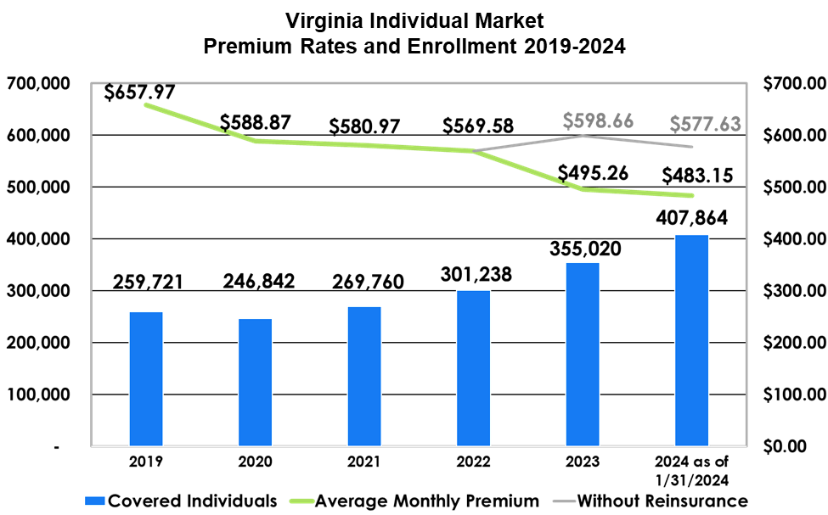
Program Impact
15

Slide 16
Marketplace coverage and competition
For PY2022, 22% of localities (30) had only one carrier on the exchange marketplace offering individual coverage.
For PY2023 (first year covered by CHRP), all localities had two or more carriers on the exchange marketplace offering individual coverage.
The number of localities covered by 3 or more carriers rose substantially, from 34% in PY2022 to 87% in PY2024.
16

Slide 17
Public Comment
17

Slide 18
Written public comment period
Comments on the CHRP may be submitted in writing:
by email to reinsurance.waiver@scc.virginia.gov; or
by postal mail to:
Bureau of Insurance – SCC
ATTN: Bradley Marsh
P.O. Box 1157
Richmond, VA 23218
Comments are due on or before Friday, July 12, 2023.
Questions may also be directed to these addresses.
18

Slide 19
Oral public comment
BOI staff members will now call upon members of the public who have requested an opportunity to speak at this forum.
19

Slide 20
Thank you for your participation!
20

