Slide 1
SCC Bureau of Insurance
2025 ACA Rate Presentations
August 22, 2024
Notes:
Photo credit: Bland & Sorkin P.C., 2022, Reciprocal Exchange Form of Insurance Company, blandsorkin.com.

Slide 2
Presentation Overview
Welcome and Introduction
The Honorable Samuel T. Towell, Commissioner
State Corporation Commission (SCC)
Broad Overview of Virginia’s Individual and Small Group Health Insurance Markets and Key Issues
Julie Blauvelt, Life & Health Division Deputy Commissioner, SCC Bureau of Insurance (BOI)
Discussion of Key Observations – Virginia’s Individual and Small group Health Insurance Rates
David Shea, Health Actuary, SCC Bureau of Insurance (BOI)
Presentation of Carriers’ Rates
Carrier Presenters
Closing
Judge Towell

Slide 3
BOI Rate Regulation
The Bureau of Insurance regulates fully-insured health insurance plans issued in Virginia, representing about 20% of Virginia's population.
The BOI's review discussed in these presentations relate to the Individual and Small Group markets.
*Source – NAIC Reports and US Census Bureau

Slide 4
Number of Carriers in Virginia's ACA Individual Market – On and Off Exchange
*2025 QHP applications received through SERFF

Slide 5
Virginia Individual Market Share by 2025 Projected Covered Lives¹
¹ Covered lives based on carrier projected member months on and off the Exchange submitted in the carrier Virginia Rate Filing Templates

Slide 6
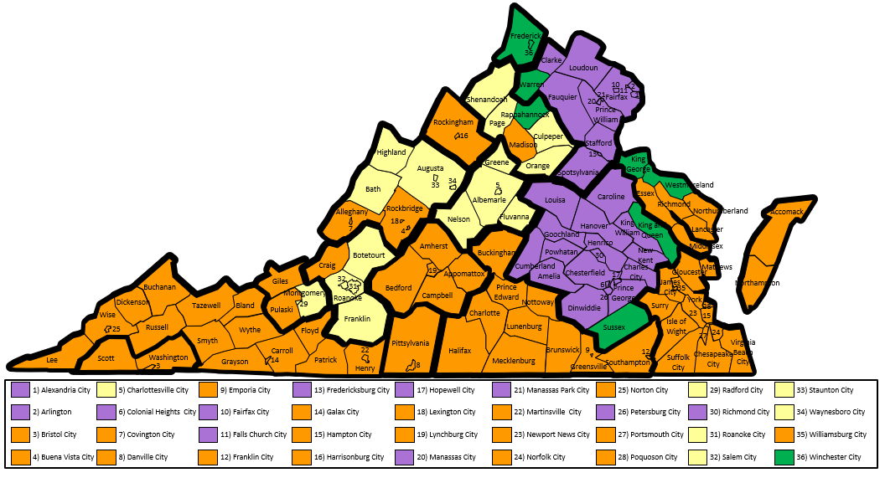
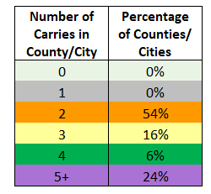
2025 Individual Market On Exchange – Carrier Service Area Applications as of 8/XX/2024
2025 Individual Market On Exchange Carrier Service Area Applications
As of 8/15/2024

Slide 7
Virginia ACA Individual Market Average Premium and Enrollment

Slide 8
Factors Affecting the Individual Market
Virginia's Insurance Marketplace

Slide 9
How have enhanced PTCs affected coverage?
The enhancements to premium tax credits were a primary cause of large marketplace enrollment gains since 2021.
Other factors: increased outreach and enrollment assistance, extended enrollment periods, and the unwinding of the Medicaid continuous coverage requirement.

Slide 10
ARPA ACA Subsidies
Average Individual Market Gross Premium PMPM
Year | ACA APTC | ACA Non-APTC
2019 | $692 | $637
2020 | $648 | $604
2021 | $660 | $326
2022 | $629 | $302
2023* | $533 | $228
'23/'23 Change | -15% | -24%
Premium Source for ACA Individual Market Enrollees Receiving APTCs
(shown as average PMPMs)
Year | Enrollee Paid | APTCs | Total | APTCS (% of Total)
2019 | $94 | $598 | $692 | 86%
2020 | $94 | $554 | $648 | 85%
2021 | $133 | $526 | $660 | 80%
2022 | $124 | $505 | $629 | 80%
2023* | $124 | $408 | $533 | 77%
*2023 represents the best estimate for full year results based on currently available data, adjusted to an annual basis

Slide 11
Commonwealth Health Reinsurance Program (CHRP)
The Commonwealth Health Reinsurance Program (CHRP) is designed to lower the cost of health insurance in Virginia’s individual market by reimbursing carriers for a portion of their high-cost claims.
In 2021, SCC was legislatively directed to apply for a State Innovation Waiver under Section 1332 of the Patient Protection and Affordable Care Act (ACA) to permit and help fund the CHRP.
SCC applied for and received federal approval to establish a reinsurance program in the individual health insurance market.
Program approved for five years, beginning in plan year (PY) 2023 (i.e., January 1, 2023 through December 31, 2023).

Slide 12
CHRP – The Way it Works
Virginia receives federal “pass-through” funding, (i.e., federal savings from reduced premium tax credits (PTCs) due to lower health insurance premiums).
PTCs are designed to bring an individual’s premium costs down to a percentage of the individual’s income.
Lower top-line premium costs reduce the amount of federal PTCs needed.
Waiver provides funding in the amount of projected savings.
Funding is passed to carriers to reduce premium.
Virginia’s estimated “state share” of CHRP funding is largely driven by individuals purchasing health insurance coverage without PTCs.
State share of the program costs will be paid from state general funds

Slide 13
CHRP Payment Parameters

Slide 14
Virginia Medicaid Redeterminations
Sources: Oliver Wyman 2025 Reinsurance Modeling Results, Carrier data call responses, effectuated enrollment reports, and publicly available data on Medicaid disenrollment numbers

Slide 15
Virginia Small Group ACA Average Premium and Enrollment
Source: 2023 and prior - premium and enrollment from experience period data submitted in carrier ACA filings.
2024 and 2025 - projected PMPM premium and enrollment from carrier ACA filings. Note: 2023 and 2024 enrollment excludes Aetna Health, Aetna Life,
Innovation HIC, Innovation Hlth Plan, Piedmont HMO and Piedmont PPO which accounted for approx. 1.5% of 2023 members.

Slide 16
Virginia Small Business Employees (2022)

Slide 17
Key Takeaways
The individual ACA market maintains healthy enrollment and stable premiums through several factors:
ARPA subsidies
Commonwealth Health Reinsurance Program
Medicaid Redeterminations
Exchange outreach/awareness of tax credits
Virginia's small group market sees enrollment holding steady and premium increases slightly better than national numbers.

Slide 18
Overview of Rate Review Process
Important consumer protection
Filing a rate revision (14VAC5-130-70 B.14) states in part that "...premiums are reasonable in relation to the benefits provided."
For individual and small group ACA, this means that the projected loss ratio (claims divided by premiums) must be at least 75%.
All of the actuarial assumptions that go into the loss ratio calculation must be reasonable and supportable
Rate review is involved with reviewing rates, NOT rate increases/decreases

Slide 19
2025 Premium Drivers
Individual (4.0%)
Trend = 6.5%
Experience = -11.1%
Morbidity = 4.0%
Small Group (6.3%)
Trend = 7.4%

Slide 20
Virginia 2025 ACA Pricing Trends
Individual
 | INPATIENT |  |  |  | OUTPATIENT |  |  |  | PHYSICIAN |  |  |  | OTHER MEDICAL |  |  |  | Rx
Carrier | Cost | Util | Total |  | Cost | Util | Total |  | Cost | Util | Total |  | Cost | Util | Total |  | Cost | Util | Total |  | TOTAL
Cigna | 10.4% | 2.5% | 13.2% |  | 2.0% | 2.5% | 4.5% |  | 2.2% | 2.5% | 4.8% |  | 7.2% | 2.5% | 9.9% |  | 7.2% | 1.0% | 8.3% |  | 7.2%
HealthKeepers | 3.1% | 1.8% | 5.0% |  | 3.1% | 1.8% | 5.0% |  | 3.1% | 1.8% | 5.0% |  | 0.4% | 0.0% | 0.4% |  | 3.6% | 5.4% | 9.2% |  | 5.8%
Small Group
 | INPATIENT |  |  |  | OUTPATIENT |  |  |  | PHYSICIAN |  |  |  | OTHER MEDICAL |  |  |  | Rx
Carrier | Cost | Util | Total |  | Cost | Util | Total |  | Cost | Util | Total |  | Cost | Util | Total |  | Cost | Util | Total |  | TOTAL
CareFirst | 7.8% | 4.7% | 12.9% |  | 5.5% | 4.4% | 10.1% |  | 3.7% | 4.6% | 8.5% |  | -1.9% | 5.0% | 3.0% |  | 5.9% | 5.7% | 11.9% |  | 9.9%
UnitedHealthcare | 3.2% | 4.6% | 7.9% |  | 3.2% | 4.6% | 7.9% |  | 3.2% | 4.6% | 7.9% |  | 3.2% | 4.6% | 7.9% |  | 3.2% | 4.6% | 7.9% |  | 7.9%
Note: These are annual rates of change to adjust claims from the experience period of calendar year 2023 to the projection period of calendar year 2025. They are based on each carrier's claims experience. Other Medical includes ambulance, home health care, DME, prosthetics, supplies, vision exams, dental and other services.

Slide 21
ACA Loss Ratio Experience
Source: Historical and projected carrier experience data submitted in the annual carrier ACA rate filings.
Note: 2020 and 2021 data excludes Virginia Premier, 2022 excludes Bright Health. 2023 Individual excludes Aetna Life and Piedmont HMO (7.2% of 3/1/23 members). 2023 Small Group excludes Aetna Health, Aetna Life, Innovation HIC, Innovation Hlth Plan, Piedmont HMO and Piedmont PPO (1.5% of 3/1/2023 members).

Slide 22
Virginia Individual ACA Market Average Rate Change
Source: Average change submitted in annual carrier ACA rate filings

Slide 23
Key Takeaways
Favorable claims experience was the primary driver of the relatively low rate change in the individual market
Pricing trends were fairly consistent with the prior year
Small group market rate change was generally a trend increase

Slide 24
Presenting Companies
Individual Market
Cigna
HealthKeepers
Small Group Market
CareFirst
UnitedHealthcare

Slide 25
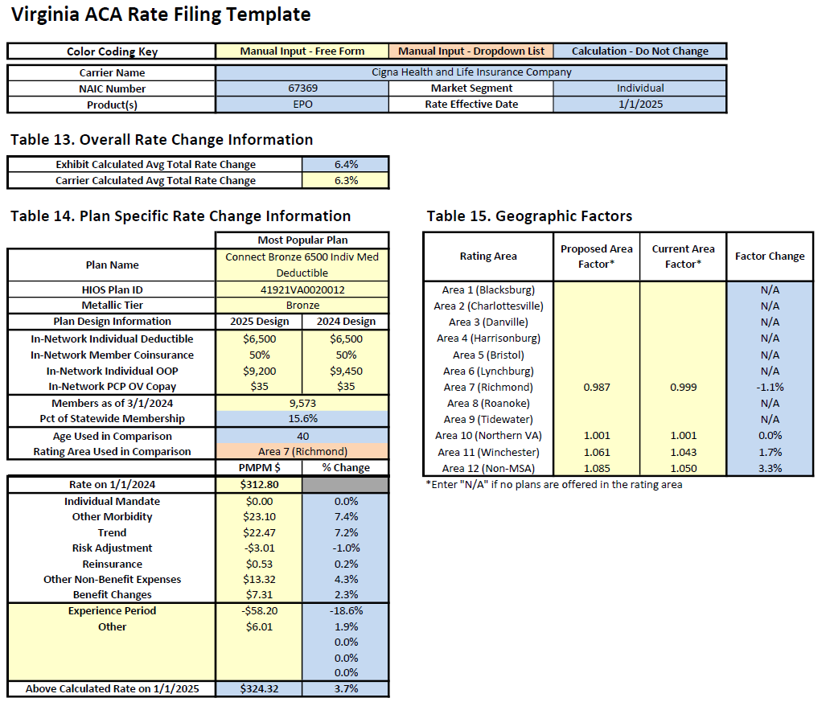
CIGNA Health and Life Insurance Company Individual

Slide 26
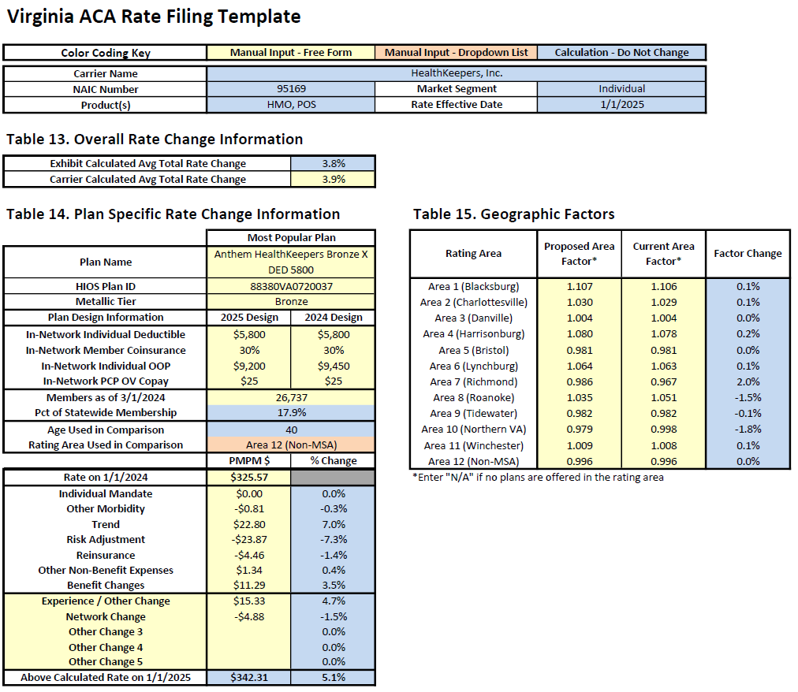
HealthKeepers, Inc. Individual

Slide 27
CareFirst BlueChoice, Inc. Small Group

Slide 28
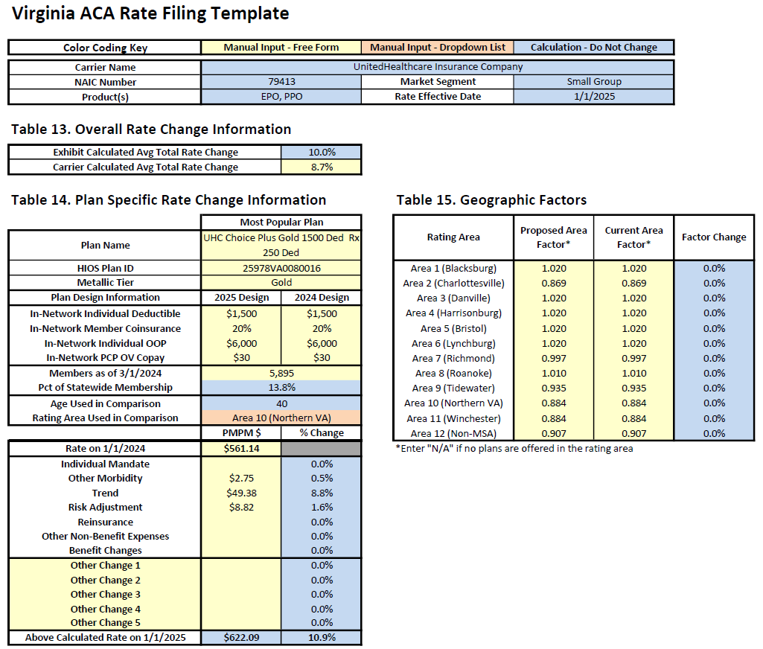
UnitedHealthcare Insurance Company Small Group

Slide 29
Aetna Health Inc. Individual

Slide 30
Anthem Health Plans of Virginia, Inc. Individual

Slide 31
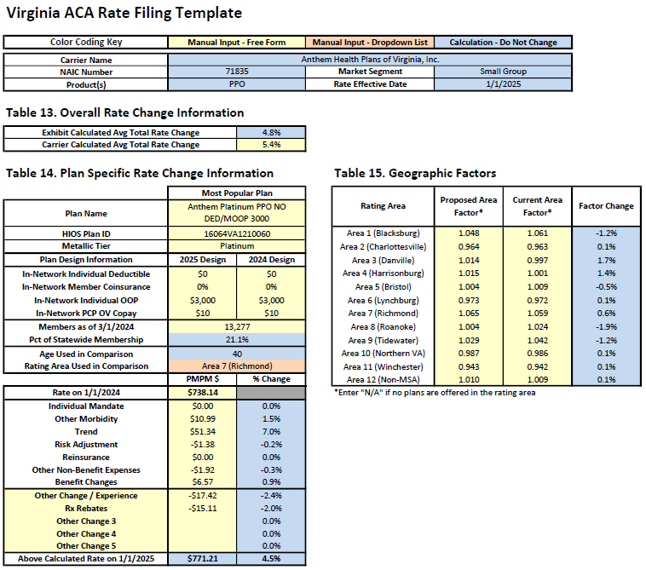
Anthem Health Plans of Virginia, Inc. Small Group

Slide 32
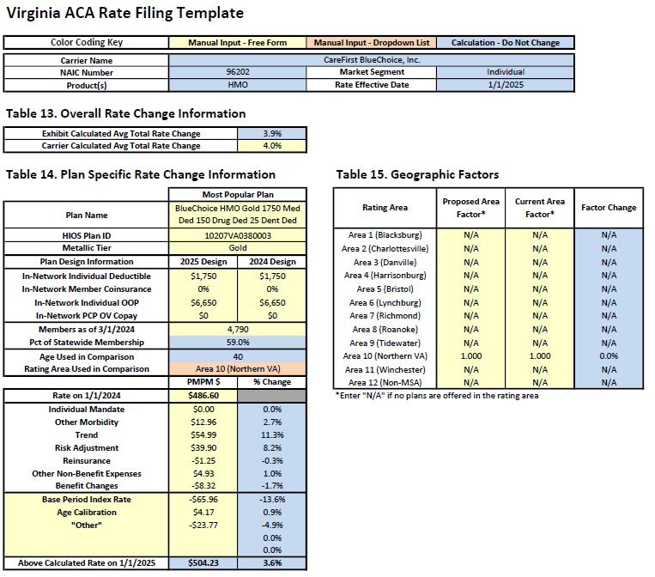
CareFirst BlueChoice, Inc. Individual

Slide 33
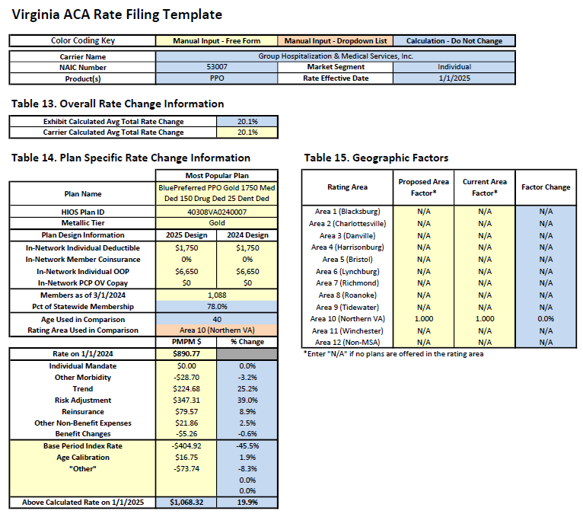
Group Hospitalization and Medical Services, Inc. Individual

Slide 34
Group Hospitalization and Medical Services, Inc. Small Group

Slide 35
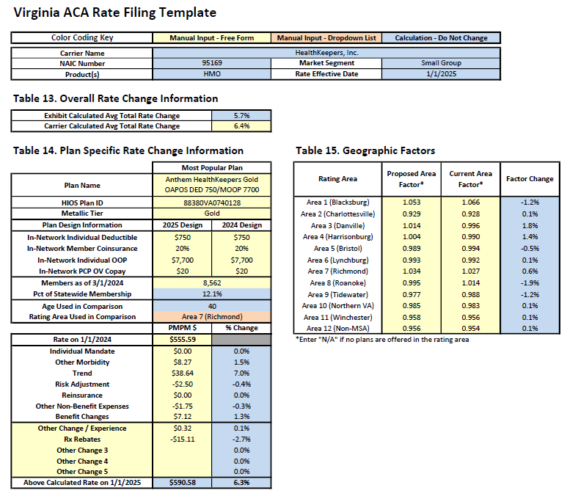
HealthKeepers, Inc. Small Group

Slide 36
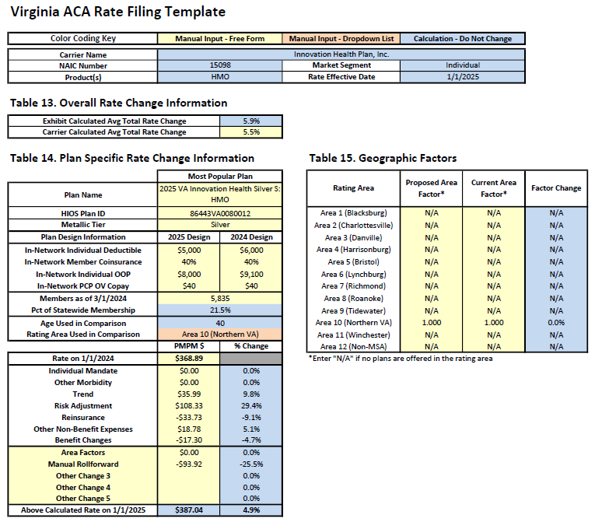
Innovation Health Plan, Inc. Individual

Slide 37
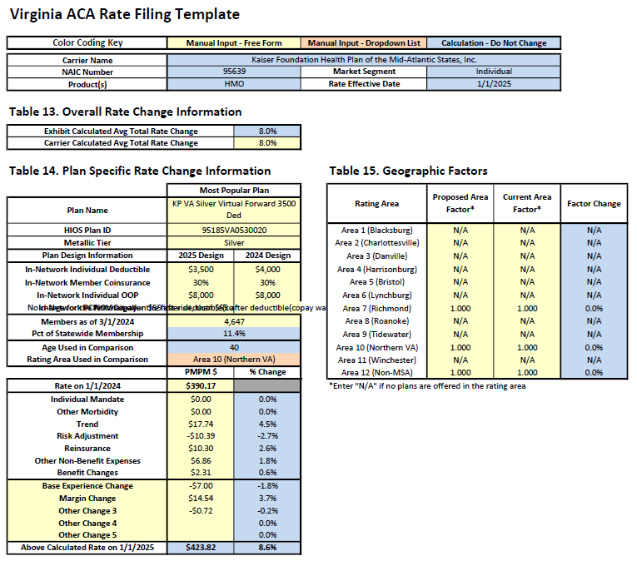
Kaiser Foundation Health Plan of the Mid-Atlantic States, Inc. Individual

Slide 38
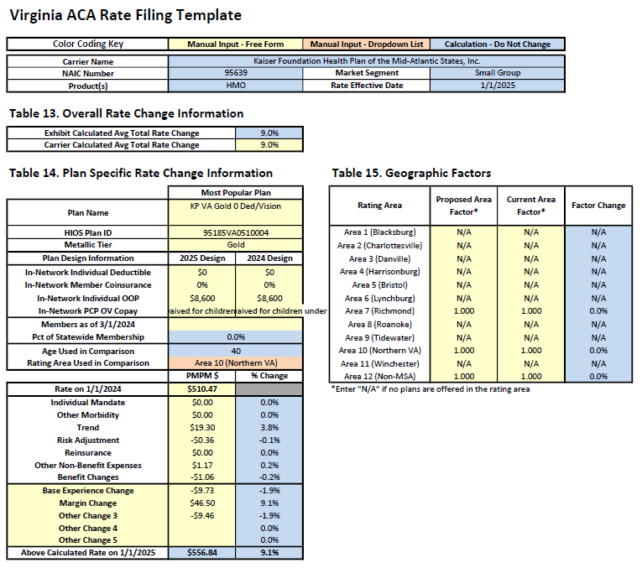
Kaiser Foundation Health Plan of the Mid-Atlantic States, Inc. Small Group

Slide 39
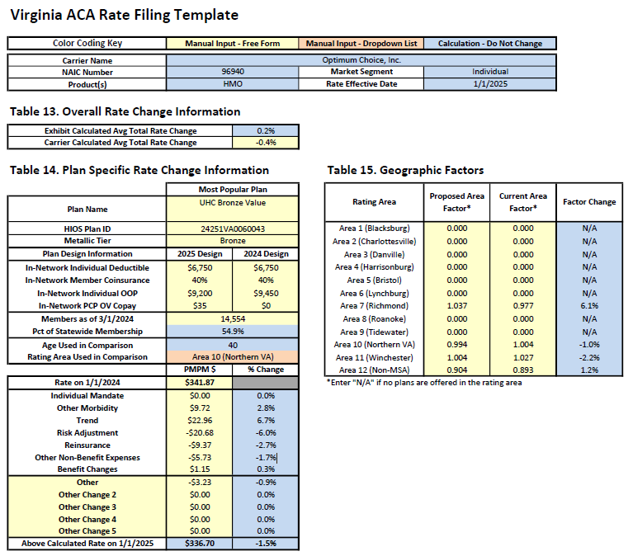
Optimum Choice, Inc. Individual

Slide 40
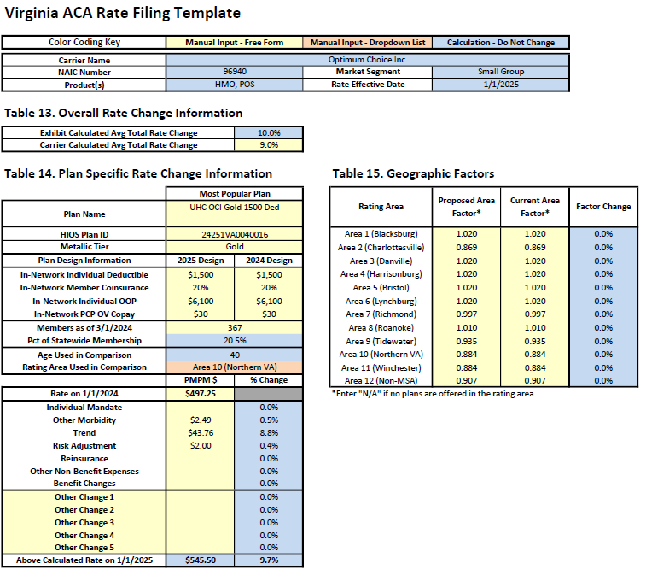
Optimum Choice, Inc. Small Group

Slide 41
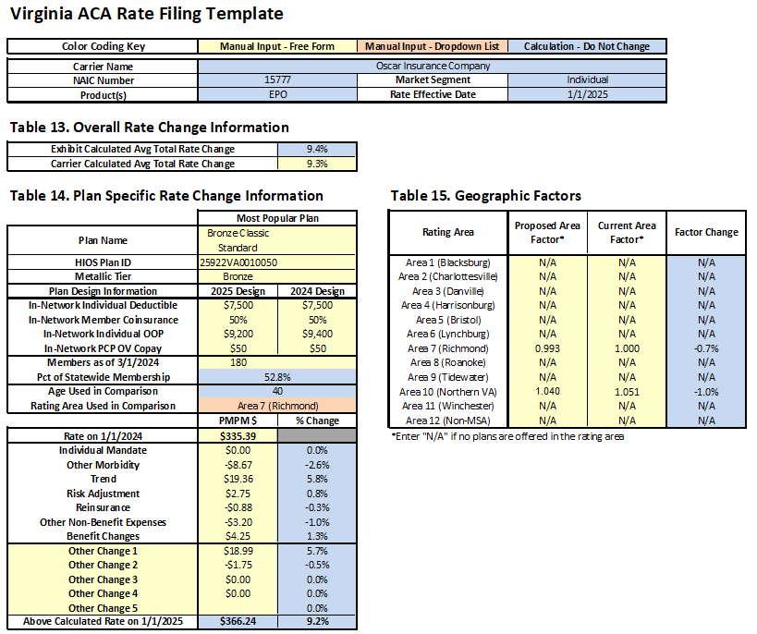
Oscar Insurance Company Individual

Slide 42
Sentara Health Insurance Company Individual

Slide 43
Sentara Health Insurance Company Small Group

Slide 44
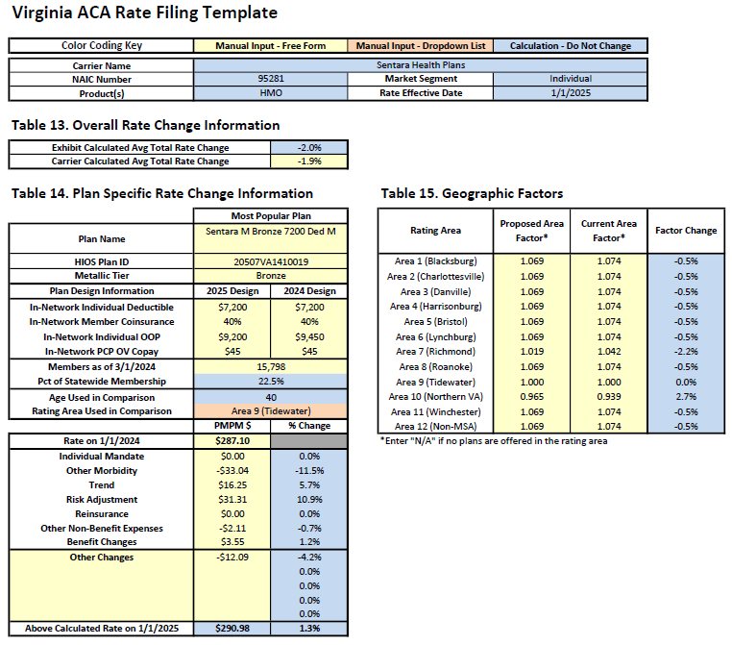
Sentara Health Plans Individual

Slide 45
Sentara Health Plans Small Group

Slide 46
UnitedHealthcare of the Mid-Atlantic, Inc. Small Group

Slide 47
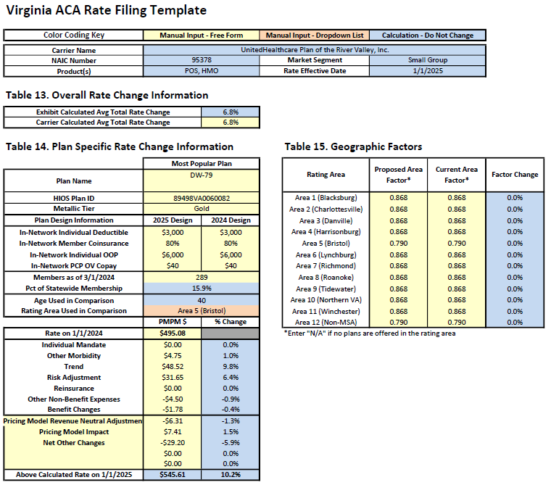
UnitedHealthcare Plan of the River Valley, Inc. Small Group

